Slide 1
Acts:
The Unhindered Harvest

Slide 3
The Empire Strikes Back
Acts 4 – Intimidation
Acts 5 – Sin
Acts 6 – Dissension
Acts 7 -- Death

Slide 4
The Empire Strikes Back
The goal of Satan is not to discourage you but to stop the plan of God.

Slide 5
Acts 4:13-18
Now as they observed the confidence of Peter and John and understood that they were uneducated and untrained men, they were amazed, and began to recognize them as having been with Jesus.

Slide 6
And seeing the man who had been healed standing with them, they had nothing to say in reply. But when they had ordered them to leave the Council, they began to confer with one another, saying,

Slide 7
“What shall we do with these men? For the fact that a noteworthy miracle has taken place through them is apparent to all who live in Jerusalem, and we cannot deny it.

Slide 8
“But so that it will not spread any further among the people, let us warn them to speak no longer to any man in this name.” And when they had summoned them, they commanded them not to speak or teach at all in the name of Jesus.

Slide 9
Bullies are Intimidating

Slide 10
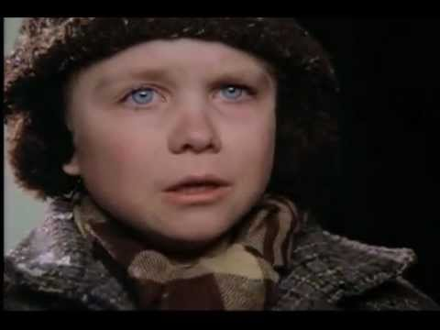
Bullies are Intimidating

Slide 11
The Occasion
A miracle
A message
A disturbance

Slide 12
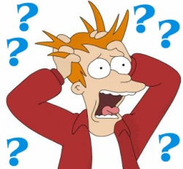
Act 1 -- Questioning
An OK question

Slide 13
Act 1 -- Questioning
A confident answer

Slide 14
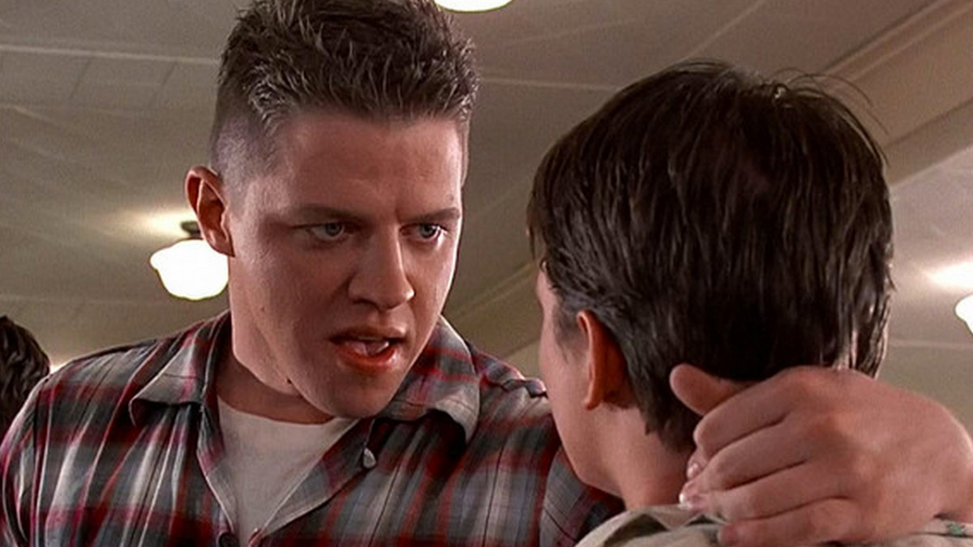
Act 2 -- Intimidation
Orders and Threats

Slide 15
Act 2 -- Intimidation
A confident answer

Slide 16
Reaping the Harvest
Don't be startled by opposition
Know the truth
Rest in God's authority

Slide 17
1st Peter 3:13-15
Who is there to harm you if you prove zealous for what is good? But even if you should suffer for the sake of righteousness, you are blessed. And do not fear their intimidation, and do not be troubled,

Slide 18
but sanctify Christ as Lord in your hearts, always being ready to make a defense to everyone who asks you to give an account for the hope that is in you, yet with gentleness and reverence;

