Slide 2
Mark 11:11-21
Jesus entered Jerusalem and came into the temple; and after looking around at everything, He left for Bethany with the twelve, since it was already late.

Slide 3
On the next day, when they had left Bethany, He became hungry. Seeing at a distance a fig tree in leaf, He went to see if perhaps He would find anything on it;

Slide 4
and when He came to it, He found nothing but leaves, for it was not the season for figs. He said to it, “May no one ever eat fruit from you again!” And His disciples were listening.

Slide 5
Then they came to Jerusalem. And He entered the temple and began to drive out those who were buying and selling in the temple,

Slide 6
and overturned the tables of the money changers and the seats of those who were selling doves;
and He would not permit anyone to carry merchandise through the temple.

Slide 7
And He began to teach and say to them, “Is it not written, ‘My house shall be called a house of prayer for all the nations’? But you have made it a robbers’ den.”

Slide 8
The chief priests and the scribes heard this, and began seeking how to destroy Him; for they were afraid of Him, for the whole crowd was astonished at His teaching.

Slide 9
When evening came, they would go out of the city. As they were passing by in the morning, they saw the fig tree withered from the roots up.

Slide 10
Jesus Visits the Temple
A significant place

Slide 11
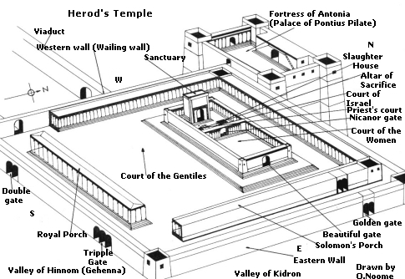
The Temple
30-35 acres
The Centerpiece
All Encompassing

Slide 12
Jesus Visits the Temple
A significant place
A second visit
A foreshadowed event

Slide 13
Jesus Cleanses the Temple
Jesus…The High Priest
Judgment
  Convenience
  Apathy & Indifference (Isaiah 56:7)
  Greed (Jeremiah 7:11)

Slide 14
Lessons from Tree and Temple
Faith
Prayer
  Ask
  Believe
Forgiveness

Slide 15
“This is a solemn reminder to us that prayer is not simply asking God for the pleasant things we desire, but an earnest yearning for, and entering into the will of God, for ourselves and others, be it sweet or bitter.” (Cole, pp. 180-181)

Slide 16
Prayer…God’s gracious provision for sinners to relate to God and participate in His accomplishment of His purposes

Slide 17
Don’t Miss the MARK
Just because God doesn’t immediately act doesn’t mean He is indifferent to, or accepting of, sin

Slide 18
Don’t Miss the MARK
God’s wrath is incited when we hinder others from coming to Him…especially by greed, selfishness, or indifference
Prayer promises aren’t for our pleasures or convenience

