Slide 1
Baptism

Slide 2
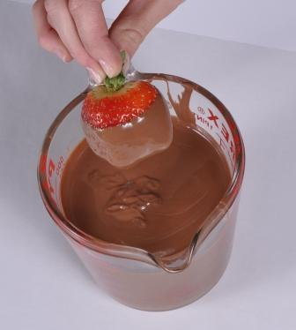
What is Baptism?
It means to…Dip

Slide 3
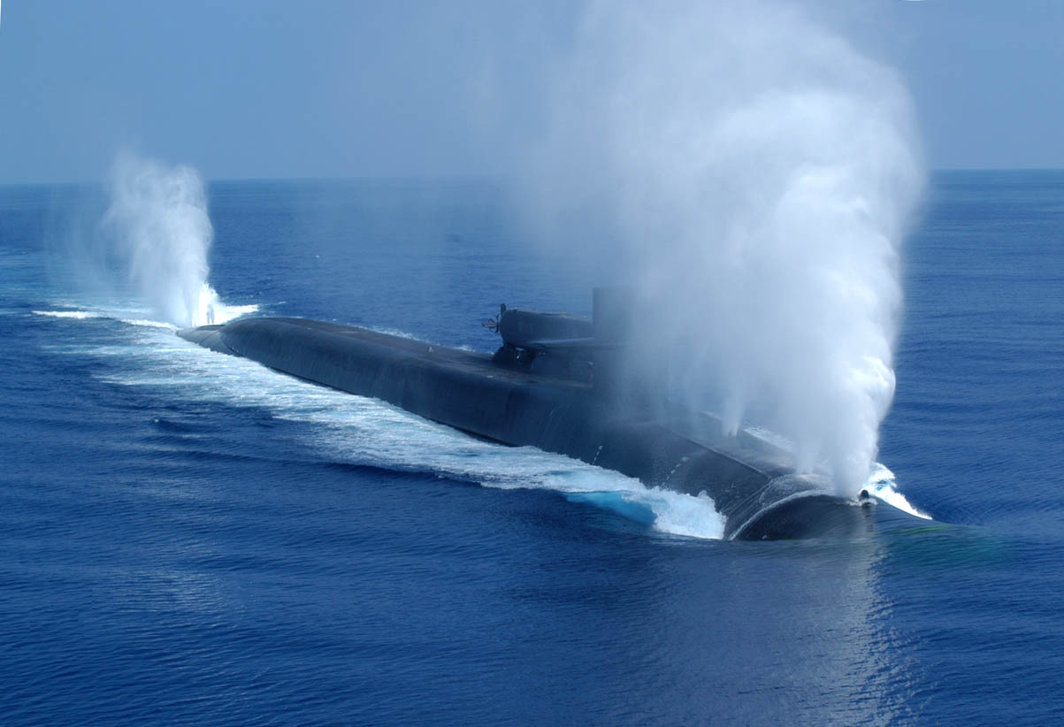
What is Baptism?
It means to…Submerge

Slide 4
What is Baptism?
It is a picture of our…
relationship with Jesus (Romans 6:3-5)
unity in Christ (1st Cor. 12:13)

Slide 5
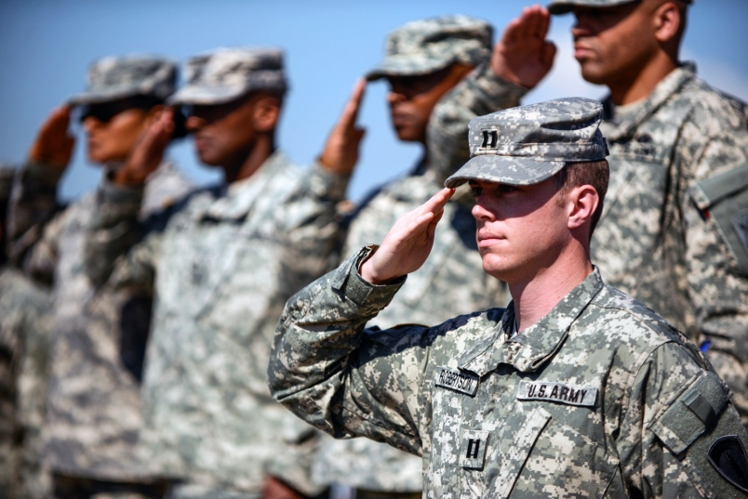
Why get baptized?
It is a command to obey (Matthew 28:18-20)

Slide 6
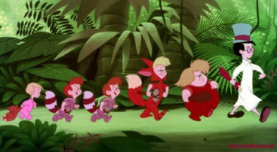
Why get baptized?
Jesus was baptized (Mark 1:9)

Slide 7
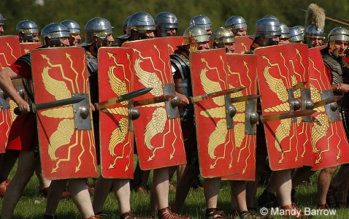
Why get baptized?
It protect us (1st Peter 3:13-22)

Slide 8
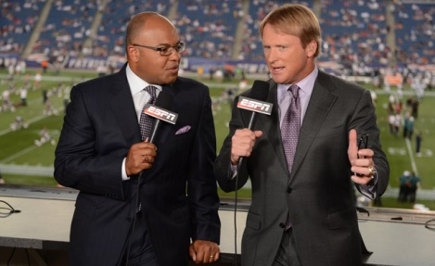
Why get baptized?
It is an announcement (1st Peter 3:13-22)

Slide 9
What about you?
Have you accepted Jesus?
Do you believe in Jesus?
Have you followed Him and obeyed Him?

