Slide 1
Acts:
The Unhindered Harvest

Slide 2
Acts 5:27-33
When they had brought them, they stood them before the Council. The high priest questioned them, saying,

Slide 3
“We gave you strict orders not to continue teaching in this name, and yet, you have filled Jerusalem with your teaching and intend to bring this man’s blood upon us.”

Slide 4
But Peter and the apostles answered, “We must obey God rather than men. “The God of our fathers raised up Jesus, whom you had put to death by hanging Him on a cross.

Slide 5
“He is the one whom God exalted to His right hand as a Prince and a Savior, to grant repentance to Israel, and forgiveness of sins.

Slide 6
“And we are witnesses of these things; and so is the Holy Spirit, whom God has given to those who obey Him.” But when they heard this, they were cut to the quick and intended to kill them.

Slide 7
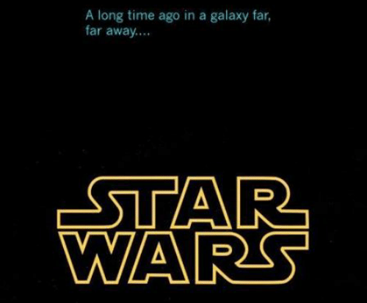

Slide 8
The Empire Strikes Back
Acts 4 – Intimidation
Acts 5 – Sin
Acts 5 -- Violence
Acts 6 – Dissension
Acts 7 -- Death

Slide 9
The Empire Strikes Back
The goal of Satan is not to discourage you but to thwart the redemptive work of God.

Slide 10
The Occasion
God was working powerfully
Many were being saved
Popularity was booming

Slide 11
The Empire Strikes Back
Selfish ambition
Escalating intensity
Arrest
Beatings
Ineffectiveness

Slide 12
The Gospel Counter
God’s provision
Message of “this Life”

Slide 13
Message of “this Life”
Obedience to God
The Resurrection
The Cross
Repentance
Forgiveness
Witness

Slide 14
The Gospel Counter
A prophetic picture
The joy set before them

Slide 15
Joyful Servants
Not rebellious
Clothed in respect and humility
Willingly accepted consequences
Deferred only to God’s authority

Slide 16
“…disciples under persecution in Acts are in continuity with their Lord; the context of persecution is mission; persecution is the occasion of divine triumph; persecution is firmly placed within divine providence…” (Peterson, pg. 217)

Slide 17
Reaping the Harvest
God’s provision isn’t primarily about our safety or comfort
Trust the message
Opposition will not last forever

Slide 18
Hebrews 12:1-3
Therefore, since we have so great a cloud of witnesses surrounding us, let us also lay aside every encumbrance and the sin which so easily entangles us, and let us run with endurance the race that is set before us,

Slide 19
fixing our eyes on Jesus, the author and perfecter of faith, who for the joy set before Him endured the cross, despising the shame, and has sat down at the right hand of the throne of God.

Slide 20
For consider Him who has endured such hostility by sinners against Himself, so that you will not grow weary and lose heart.

