Slide 1
Acts:
The Unhindered Harvest

Slide 2
Acts 6:8-14
And Stephen, full of grace and power, was performing great wonders and signs among the people.

Slide 3
But some men from what was called the Synagogue of the Freedmen, including both Cyrenians and Alexandrians, and some from Cilicia and Asia, rose up and argued with Stephen.

Slide 4
But they were unable to cope with the wisdom and the Spirit with which he was speaking. Then they secretly induced men to say, “We have heard him speak blasphemous words against Moses and against God.”

Slide 5
And they stirred up the people, the elders and the scribes, and they came up to him and dragged him away and brought him before the Council.

Slide 6
They put forward false witnesses who said, “This man incessantly speaks against this holy place and the Law;

Slide 7
for we have heard him say that this Nazarene, Jesus, will destroy this place and alter the customs which Moses handed down to us.”

Slide 8
And fixing their gaze on him, all who were sitting in the Council saw his face like the face of an angel.

Slide 9
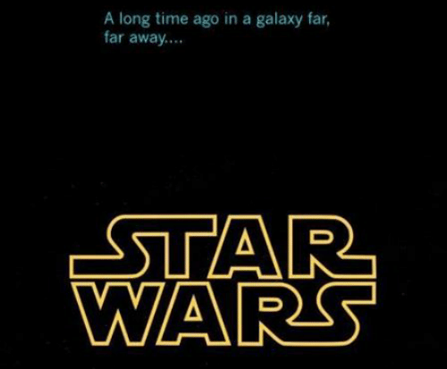

Slide 10
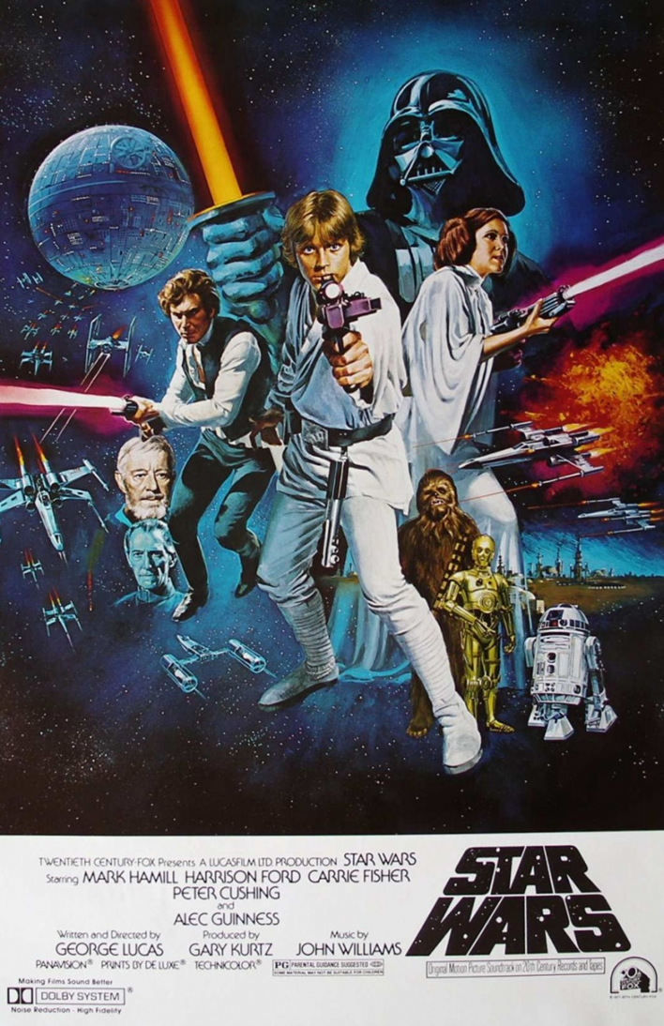
A New Hope
God promised
Jesus came
Jesus went to the cross
Jesus rose from the grave
The Holy Spirit came
Sinners saved

Slide 11
The Empire Strikes Back
Acts 4 – Intimidation
Acts 5 – Sin
Acts 5 -- Torture
Acts 6 – Dissension
Acts 7 -- Death

Slide 12
The Empire Strikes Back
The goal of Satan is not to discourage you but to thwart the redemptive work of God.

Slide 13
Sound Familiar?
A conspiracy (vs. 11)
False witness (vs. 13)
Accused of attacking the Jewish pillars (vs. 13)
Twisted his words (vs. 14)

Slide 14
Sound Familiar?
Experienced by Jesus
Promised by Jesus
Matthew 5:11-12
John 15:20

Slide 15
A Tale of Two Trials
Trial #1…the State vs. Stephen
Charge 1…blasphemy
Charge 2…complicity
He offers no defense
He does not seek acquittal

Slide 16
A Tale of Two Trials
Trial #2…Stephen vs. the State
The charge…rejecting God

Slide 17
The Evidence
God made a promise
To Abraham
A great nation
To be enslaved
To be released
To serve the Lord

Slide 18
The Evidence
Israel rejected its “savior” (Joseph)
Israel rejected its “redeemer” (Moses)
Israel rejected its Covenant-Lord (God)

Slide 19
The Verdict
Stephen v. The State
Guilty of rejecting God
Guilty of rejecting His servants
Guilty of rejecting the Covenant
Separated from God

Slide 20
The Verdict
State v. Stephen
Guilty
Sentenced to Death

Slide 21
Reaping the Harvest
See and understand idolatry
Don’t focus on acquittal
Focus on Jesus

Slide 22
1st Peter 1:6-9
In this you greatly rejoice, even though now for a little while, if necessary, you have been distressed by various trials,

Slide 23
so that the proof of your faith, being more precious than gold which is perishable, even though tested by fire, may be found to result in praise and glory and honor at the revelation of Jesus Christ;

Slide 24
and though you have not seen Him, you love Him, and though you do not see Him now, but believe in Him, you greatly rejoice with joy inexpressible and full of glory, obtaining as the outcome of your faith the salvation of your souls.

