Slide 1
Acts:
The Unhindered Harvest

Slide 2
Acts 8:4-8
Therefore, those who had been scattered went about preaching the word. Philip went down to the city of Samaria and began proclaiming Christ to them.

Slide 3
The crowds with one accord were giving attention to what was said by Philip, as they heard and saw the signs which he was performing.

Slide 4
For in the case of many who had unclean spirits, they were coming out of them shouting with a loud voice; and many who had been paralyzed and lame were healed.

Slide 5
So there was much rejoicing in that city.

Slide 6
Going

Slide 7
Proclaiming

Slide 8
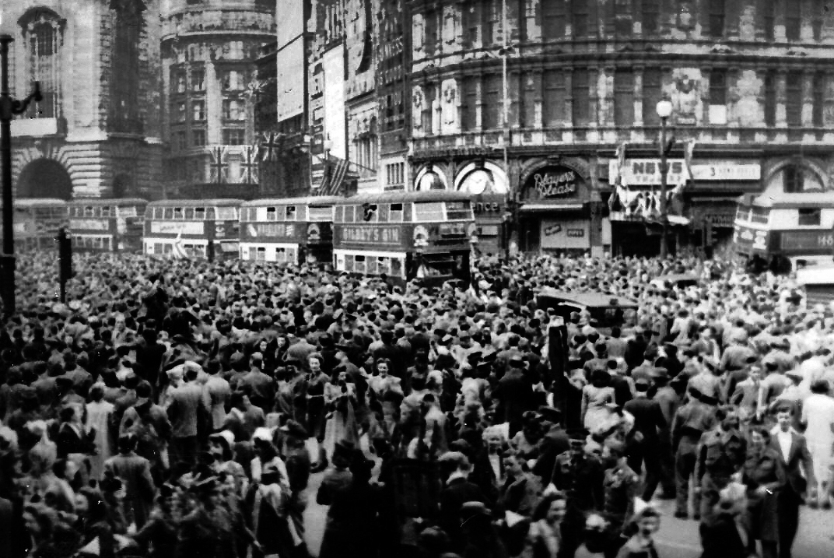
Victory

Slide 9
Joy

Slide 10
Reaping the Harvest
Jesus goes with you
Give people the play-by-play
Jesus brings victory and joy

