Slide 1
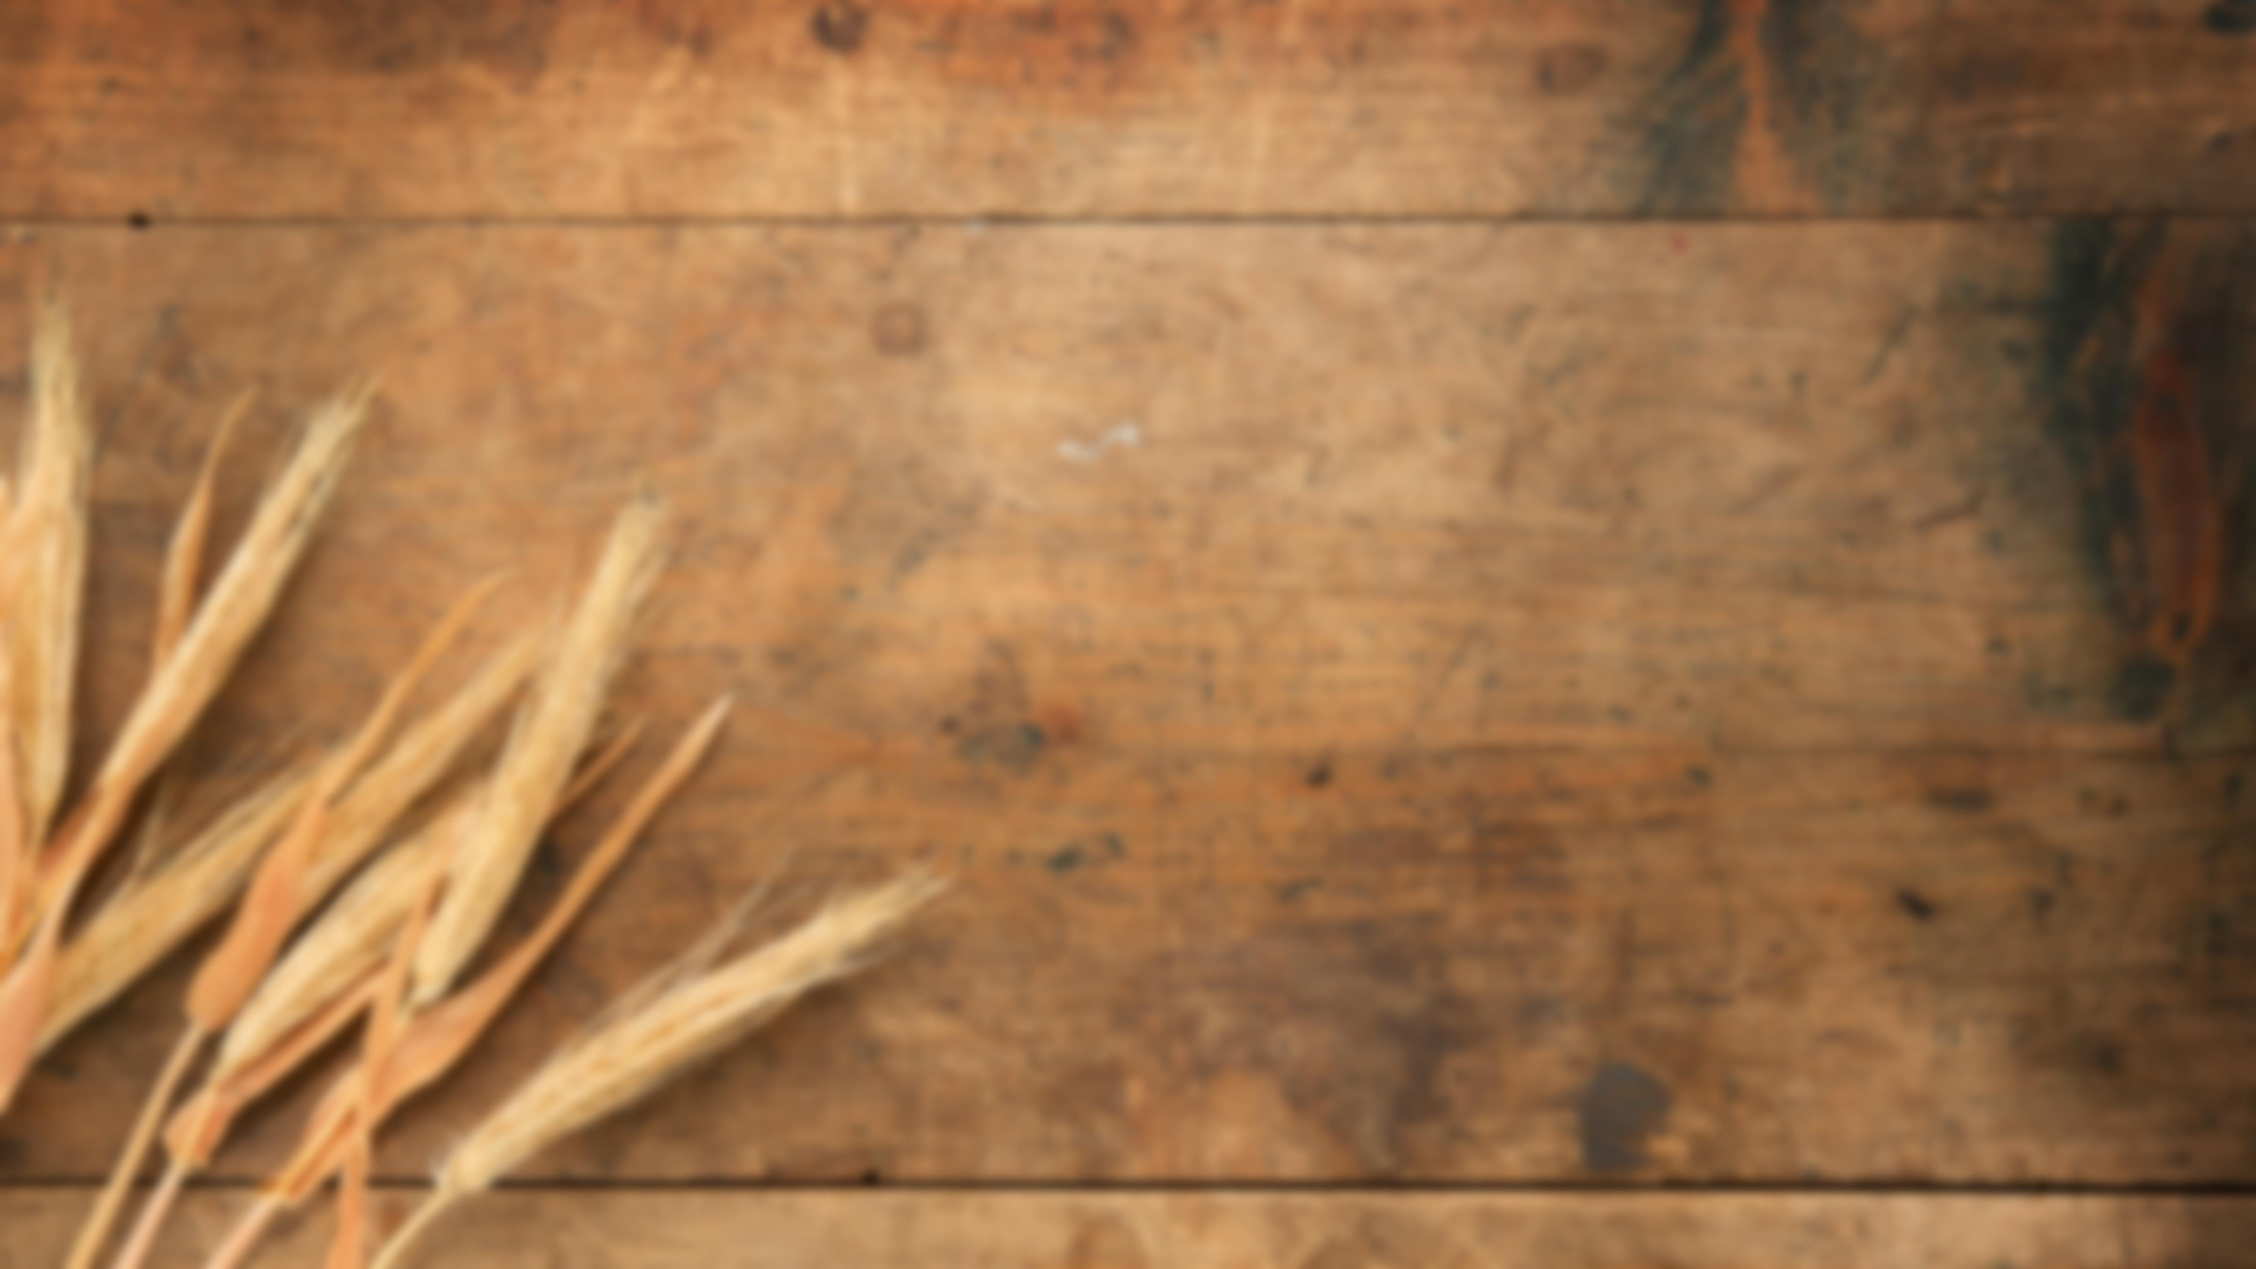
Acts:
The Unhindered Harvest

Slide 2

Hebrews 2:14-18
Therefore, since the children share in flesh and blood, He Himself likewise also partook of the same, that through death He might render powerless him who had the power of death, that is, the devil,

Slide 3
and might free those who through fear of death were subject to slavery all their lives.
16 For assuredly He does not give help to angels, but He gives help to the descendant of Abraham.

Slide 4
Therefore, He had to be made like His brethren in all things, so that He might become a merciful and faithful high priest in things pertaining to God, to make propitiation for the sins of the people.

Slide 5
For since He Himself was tempted in that which He has suffered, He is able to come to the aid of those who are tempted.

Slide 6
Hebrews 4:14-16
Therefore, since we have a great high priest who has passed through the heavens, Jesus the Son of God, let us hold fast our confession.

Slide 7
For we do not have a high priest who cannot sympathize with our weaknesses, but One who has been tempted in all things as we are, yet without sin.

Slide 8
Therefore let us draw near with confidence to the throne of grace, so that we may receive mercy and find grace to help in time of need.

Slide 9
The Highlights
He became like us so He could die for us
Had to die as one of us to save us
  The promise of God
  The wages of sin

Slide 10
The Highlights
Had to be like us to save us
  To be our sacrifice
  To serve as High Priest
Had to deal with the violator and the violation of God’s holiness

Slide 11
The Highlights
He came down to us
He identifies with us
He is sympathetic to us
He aids us in our weakness

Slide 13
Jeremiah 31:31-34
“Behold, days are coming,” declares the Lord, “when I will make a new covenant with the house of Israel and with the house of Judah,

Slide 14
Jeremiah 31:31-34
“Behold, days are coming,” declares the Lord, “when I will make a new covenant with the house of Israel and with the house of Judah,

Slide 15
not like the covenant which I made with their fathers in the day I took them by the hand to bring them out of the land of Egypt, My covenant which they broke, although I was a husband to them,” declares the Lord.

Slide 16
“But this is the covenant which I will make with the house of Israel after those days,” declares the Lord, “I will put My law within them and on their heart I will write it; and I will be their God, and they shall be My people.

Slide 17
“They will not teach again, each man his neighbor and each man his brother, saying, ‘Know the Lord,’ for they will all know Me, from the least of them to the greatest of them,” declares the Lord,

Slide 18
“for I will forgive their iniquity, and their sin I will remember no more.”

Slide 19
The Highlights
New vs. Old
Old Covenant
  The Law
  Governed obedience
  Demonstrated sinfulness
  Temporary

Slide 20
The Highlights
New Covenant
  Made with Israel
  Mediated by the Holy Spirit
  Forgiveness not Passover
  Permanent
  Unbreakable

