Slide 2
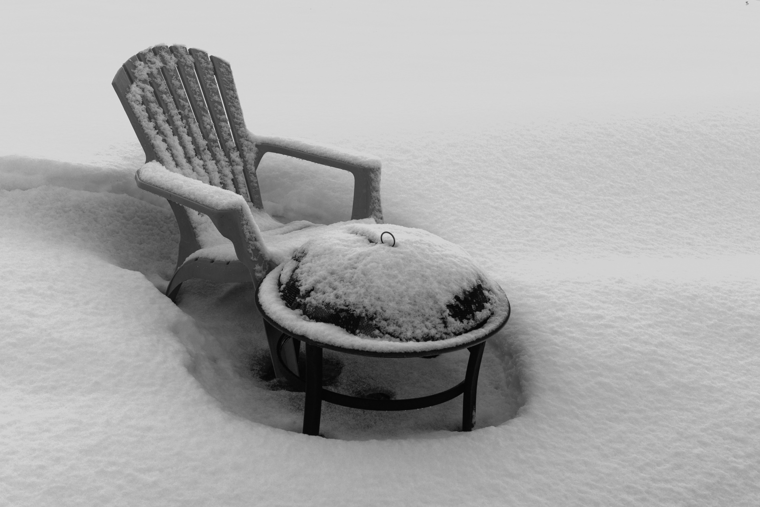
HOPE

Slide 3
Isaiah 9:2-7
The people who walk in darkness Will see a great light; Those who live in a dark land, The light will shine on them.

Slide 4
You shall multiply the nation, You shall increase their gladness; They will be glad in Your presence As with the gladness of harvest, As men rejoice when they divide the spoil.

Slide 5
For You shall break the yoke of their burden and the staff on their shoulders, The rod of their oppressor, as at the battle of Midian.

Slide 6
For every boot of the booted warrior in the battle tumult, And cloak rolled in blood, will be for burning, fuel for the fire.

Slide 7
For a child will be born to us, a son will be given to us; And the government will rest on His shoulders; And His name will be called Wonderful Counselor, Mighty God, Eternal Father, Prince of Peace.

Slide 8
There will be no end to the increase of His government or of peace, On the throne of David and over his kingdom,

Slide 9
To establish it and to uphold it with justice and righteousness From then on and forevermore. The zeal of the Lord of hosts will accomplish this.

Slide 10
What Child is this? Light.
Must understand Darkness
Social, cultural, political
Spiritual
Light
…to be seen
…to shine
Triad (Genesis 1, Isaiah 9, John 1)

Slide 11
What Child is this? Gladness and Joy.
Multiplication and Increase
Why?
Deliverance
Victory
A Child born

Slide 12
What Child is this? The Promised One.
Born as well as given
Right and responsibility to rule
Titles or names?
Perfectly epitomizes
Perfectly fulfills
Who he is

Slide 13
What Child is this? The Promised One.
The context is political
“Government” and “throne”
Statesman
Deliverer
Guardian
Ruler

Slide 14
“…the unique dignity of this deliverer cannot be covered by single names…no one name can comprehend the multitude of blessings that he brings or the…works…he successfully achieves.” (Leupold, pg. 185)

Slide 15
What Child is this? The Promised One.
The perfect David
Assured by God

Slide 16
What’s in the manger?
Assurance and hope
Process…spiritual before physical
A call to choose
Light or darkness
Victory or defeat
Glory or shame

