Slide 1
Acts:
The Unhindered Harvest

Slide 2
The Narrative in Acts
How the gospel spreads
How the gospel works
How God works

Slide 3
Acts 16:11-15
So putting out to sea from Troas, we ran a straight course to Samothrace, and on the day following to Neapolis;

Slide 4
and from there to Philippi, which is a leading city of the district of Macedonia, a Roman colony; and we were staying in this city for some days.

Slide 5
And on the Sabbath day we went outside the gate to a riverside, where we were supposing that there would be a place of prayer; and we sat down and began speaking to the women who had assembled.

Slide 6
A woman named Lydia, from the city of Thyatira, a seller of purple fabrics, a worshiper of God, was listening; and the Lord opened her heart to respond to the things spoken by Paul.

Slide 7
And when she and her household had been baptized, she urged us, saying, “If you have judged me to be faithful to the Lord, come into my house and stay.” And she prevailed upon us.
New American Standard Bible : 1995 Update. LaHabra, CA : The Lockman Foundation, 1995

Slide 8
16:12
16:11
The Journey’s Route

Slide 9
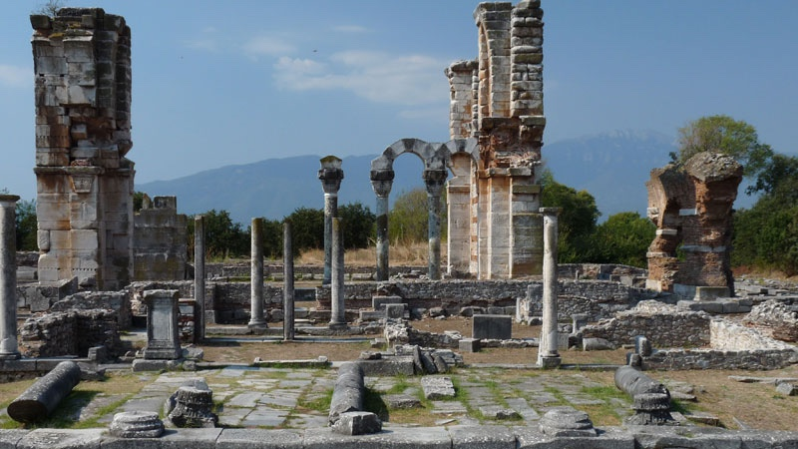
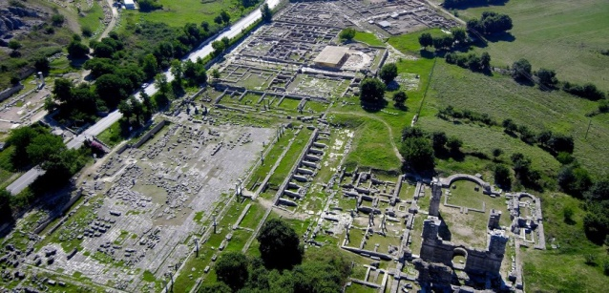
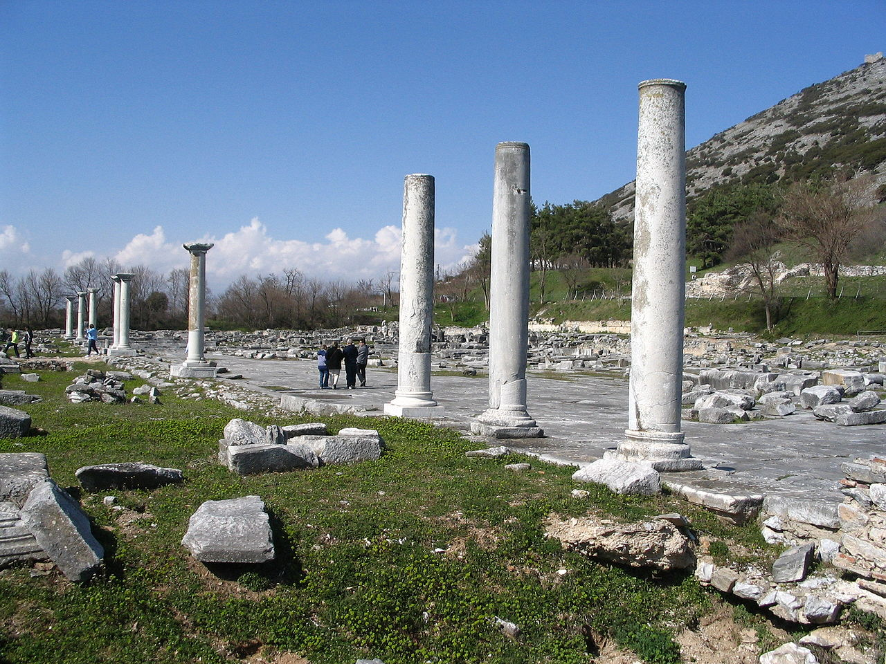
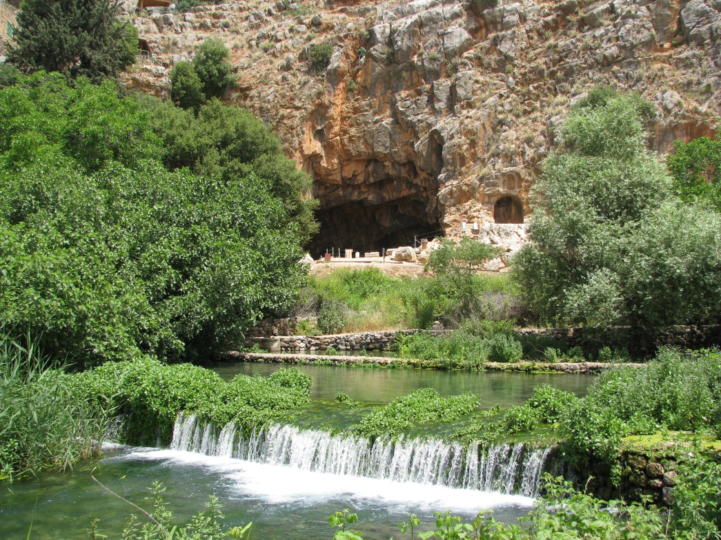
The Location…Philippi

Slide 10
Single…widowed or unmarried
Entrepreneur
Wealthy
Religious
Humble
BUT…

Slide 11
She needed more
God opened her heart
Jesus…crucified…risen
Lord…Savior…King
Personally responded

Slide 12
Communion…Time to Respond
Worship
Submission
Faith

Slide 13
Communion…Time to Respond
Bread
Jesus’ body
Given for you
Cup
Jesus’ blood
New Covenant

Slide 15
Fellowship

