Slide 1
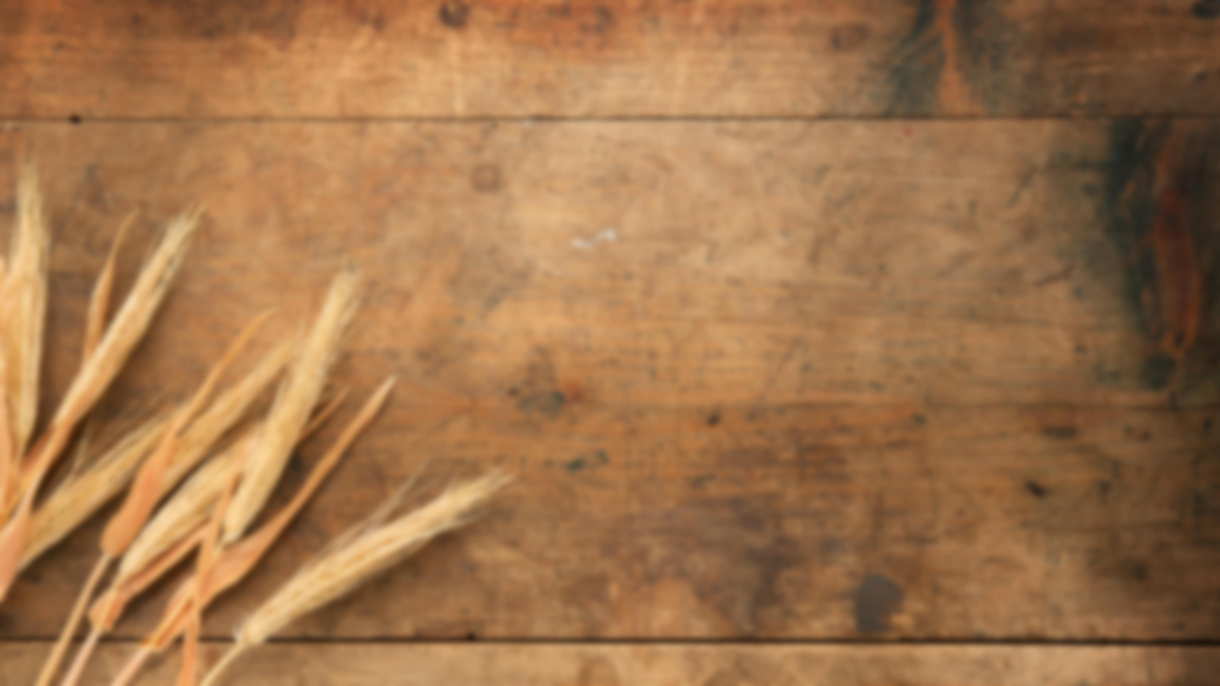
Acts:
The Unhindered Harvest

Slide 2

Acts 16:16-19
It happened that as we were going to the place of prayer, a slave-girl having a spirit of divination met us, who was bringing her masters much profit by fortune-telling.

Slide 3
Following after Paul and us, she kept crying out, saying, “These men are bond-servants of the Most High God, who are proclaiming to you the way of salvation.”

Slide 4
She continued doing this for many days. But Paul was greatly annoyed, and turned and said to the spirit,

Slide 5
“I command you in the name of Jesus Christ to come out of her!” And it came out at that very moment.

Slide 6
But when her masters saw that their hope of profit was gone, they seized Paul and Silas and dragged them into the market place before the authorities,
New American Standard Bible : 1995 Update. LaHabra, CA : The Lockman Foundation, 1995

Slide 7
A Poignantly Powerful Picture
A girl in bondage
  Humanly
  Spiritually

Slide 8
A Poignantly Powerful Picture
The message was in bondage
  Faithless affirmation
  Negative association
  Misconstrued message
A release from bondage

Slide 9
A Poignantly Powerful Picture
The messengers were in bondage
  Racism at its finest
  Law-breaking at its best
  Governmental fear in full measure

Slide 10
A Picture to Prepare & Empower
Chained but not bound
  Prayer
  Praise
The breaking of bondage
  Their chains
  Their message

Slide 11
A Picture to Prepare & Empower
Souls set free
  By faith
  By the power of God in Christ
  A jailer taken captive by Christ

Slide 12
A Picture to Prepare & Empower
A heart held captive
  For the sake of the message
  For the sake of believers

Slide 13

Reaping the Harvest
The gospel is the power of God
Your miracle may not be for your deliverance
Nothing can bind a heart of faith

Slide 14
Romans 1:16-17
For I am not ashamed of the gospel, for it is the power of God for salvation to everyone who believes, to the Jew first and also to the Greek.

Slide 15
For in it the righteousness of God is revealed from faith to faith; as it is written, “But the righteous man shall live by faith.”
New American Standard Bible : 1995 Update. LaHabra, CA : The Lockman Foundation, 1995

