Slide 1
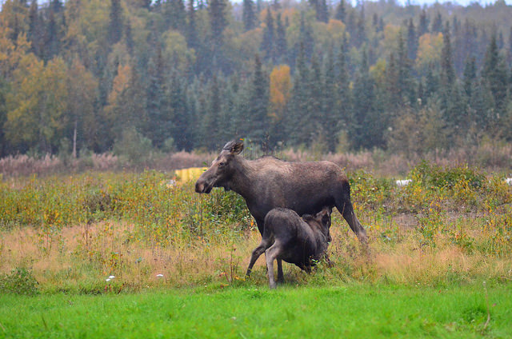
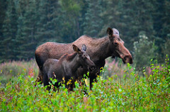
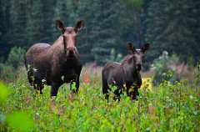
Happy Mothers Day!

Slide 2
It’s Mother’s Day which means…
A chance to frustrate
A chance to burden
A chance to hurt
A chance to be arrogant

Slide 3
Many Good Moms
Moses’ mom
Naomi (Ruth’s M-I-L)
Timothy’s mom
Timothy’s grandma
Best mom…
Mary, Jesus’ mom

Slide 4
Mary’s Story
Awkward beginnings
So young for so much
A challenging child
The horror of it all
Not her story but her faith

Slide 6
Luke 1:46-55
And Mary said: “My soul exalts the Lord, And my spirit has rejoiced in God my Savior. For He has had regard for the humble state of His bond-slave; For behold, from this time on all generations will count me blessed.

Slide 7
For the Mighty One has done great things for me; And holy is His name. And His mercy is upon generation after generation Toward those who fear Him.

Slide 8
He has done mighty deeds with His arm; He has scattered those who were proud in the thoughts of their heart. He has brought down rulers from their thrones, And has exalted those who were humble.

Slide 9
He has filled the hungry with good things; And sent away the rich empty-handed. He has given help to Israel His servant, In remembrance of His mercy, As He spoke to our fathers, To Abraham and his descendants forever.”
New American Standard Bible : 1995 Update. LaHabra, CA : The Lockman Foundation, 1995

Slide 10
Mary’s Magnificence
Her Humility
"The quality of Mary that shines most clearly through this passage is a deep sense of humility." (MacArthur)

Slide 11
Mary’s Magnificence
Her recognition of God’s greatness
Her faith in God’s promise

Slide 12
“It reveals that Mary's heart and
mind were saturated with the Word of God. It contains…numerous allusions to the law, the psalms,
and the prophets. The entire passage is a point-by-point reciting of the covenant promises of
God." (MacArthur)

Slide 13
This was one mother’s story…but its not about a mom. It is about a life yielded to the Savior and faithfully lived for Him.
It can be your story (even if you aren’t a mom!).

Slide 14
Magnificent Like Mary
Be humble before God
Acknowledge your need for a savior
Trust the promise of God
Saturate your heart and mind with God’s Word

