Slide 1
Acts:
The Unhindered Harvest

Slide 2
The Dangers we Face
The Bible
Overwhelmed by greatness
Underwhelmed by comparison
Dismissive of direction

Slide 3
Reminders
Acts – how God works
Acts – how God fulfills
Acts – how people fit
Acts – how ordinary people fit

Slide 4
Acts 18:1-5
After these things he left Athens and went to Corinth. And he found a Jew named Aquila, a native of Pontus,

Slide 5
having recently come from Italy with his wife Priscilla, because Claudius had commanded all the Jews to leave Rome.

Slide 6
He came to them, and because he was of the same trade, he stayed with them and they were working, for by trade they were tent-makers.

Slide 7
And he was reasoning in the synagogue every Sabbath and trying to persuade Jews and Greeks.

Slide 8
But when Silas and Timothy came down from Macedonia, Paul began devoting himself completely to the word, solemnly testifying to the Jews that Jesus was the Christ.
New American Standard Bible : 1995 Update. LaHabra, CA : The Lockman Foundation, 1995

Slide 9
Some Context
Corinth
Strategic location
Central hub
Gathering point
Petri dish

Slide 10
Some Context
Paul…(behind the scenes)
Trouble, toil, and turmoil (everywhere!)
Fear and trembling
Fear and depression

Slide 11
God’s Pertinent Provisions
Comrades
Shared experiences
Shared lifestyle
Burden-bearers
Carried a weight
Gave freedom

Slide 12
God’s Pertinent Provisions
A hospitable servant
Purposeful
Strategic
A replacement
Someone better (WHAT?!)
Freedom-giver

Slide 13
God’s Pertinent Provisions
God’s revelation
Confidence
Assurance
Context
Paul knew yet needed

Slide 14
God’s Pertinent Provisions
Protector
God can use the Godless
God is sovereign (truly!)
Co-laborers
Sharing the vision
Sharing the work
In relationship

Slide 15
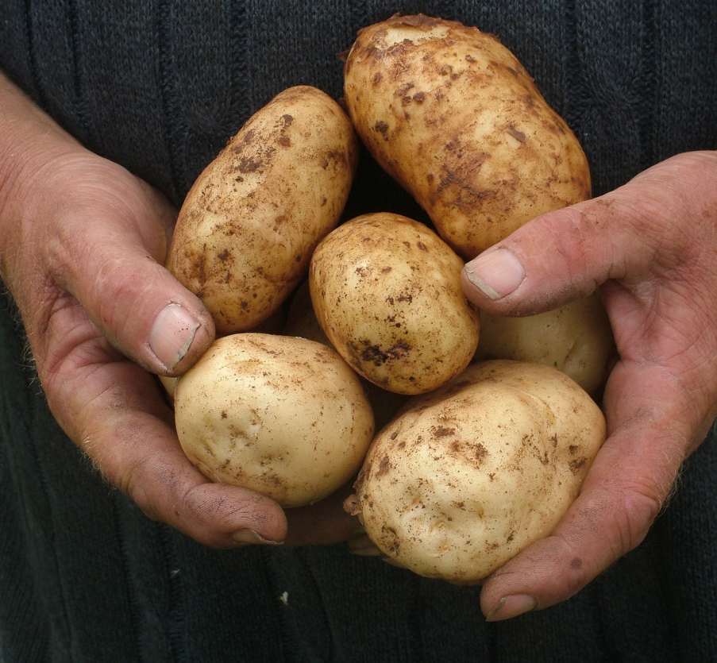
Reaping the Harvest
Neediness is normative
You are essential
Others are essential
The Bible is essential

