Slide 1
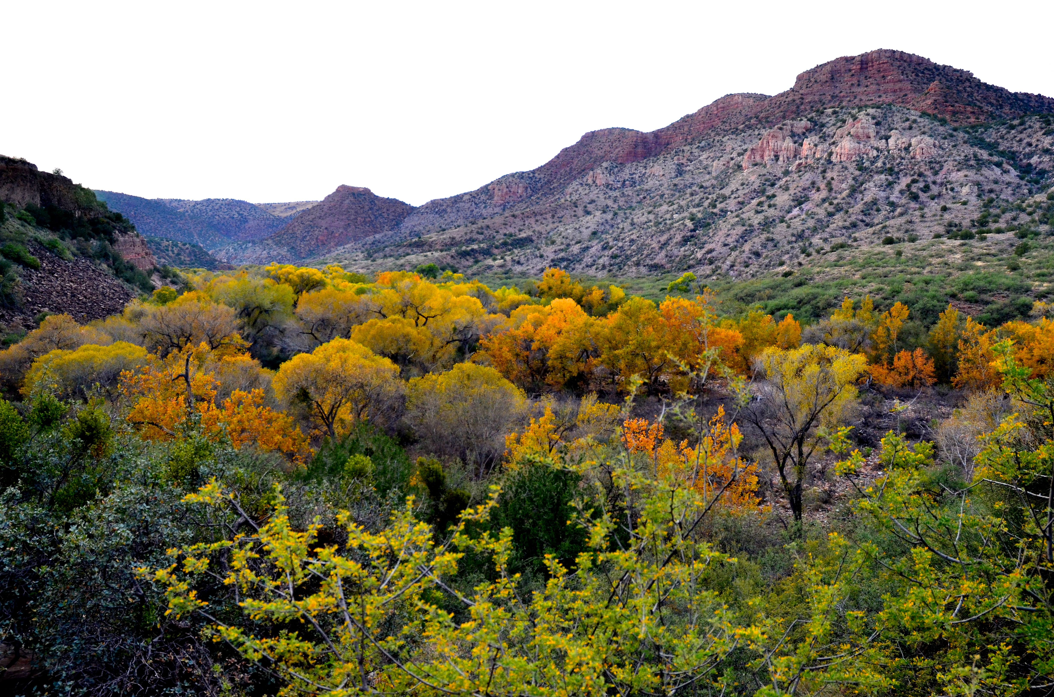

Slide 2
Psalm 121
I will lift up my eyes to the mountains; From where shall my help come? My help comes from the Lord, Who made heaven and earth.

Slide 3
He will not allow your foot to slip; He who keeps you will not slumber. Behold, He who keeps Israel Will neither slumber nor sleep.

Slide 4
The Lord is your keeper; The Lord is your shade on your right hand. The sun will not smite you by day, Nor the moon by night.

Slide 5
The Lord will protect you from all evil; He will keep your soul. The Lord will guard your going out and your coming in From this time forth and forever.
New American Standard Bible : 1995 Update. LaHabra, CA : The Lockman Foundation, 1995

Slide 6
A Song of Ascents (Psalms 120-134)
Sung approaching Jerusalem
  Worshippers attending festivals
  Priests ascending the Temple steps
All filled with hope
A Psalm of trust

Slide 7
My Need
  Mountains…intimidating not inspiring
  Recognition of need
  Recognition of my neediness

Slide 8
My Helper
  The Lord
  Creator
  The “shamar” (Keeper)

Slide 9
My Helper
"Sentry duty was normally assigned to the ordinary soldier. Here it is the Lord who has assumed this responsibility." (Leupold, pg. 870)

Slide 10
The Lord keeps me from me
  Protection from stumbling, tripping, or slipping
  My lack of agility
  My lack of perceptivity
  Always attentive and focused

Slide 12
The Lord keeps me from evil
  The sun…that which withers
  The moon…dangers of the dark
  Eternal as well as temporal
  The entirety of our lives

Slide 14
Jude 24-25
Now to Him who is able to keep you from stumbling, and to make you stand in the presence of His glory blameless with great joy,

Slide 15
to the only God our Savior, through Jesus Christ our Lord, be glory, majesty, dominion and authority, before all time and now and forever. Amen.
New American Standard Bible : 1995 Update. LaHabra, CA : The Lockman Foundation, 1995

