Slide 1
Acts:
The Unhindered Harvest

Slide 2
The Thessalonian Letters
The Story of Acts
A sample of the harvest
Follow-up letters
An intimate look at…
Paul’s heart
Thessalonians faith

Slide 3
The Thessalonian Letters
An intimate look at us
Our desires
Our dreams
Our fantasies

Slide 4
1st Thessalonians 1:1-7
Paul and Silvanus and Timothy, To the church of the Thessalonians in God the Father and the Lord Jesus Christ: Grace to you and peace.

Slide 5
We give thanks to God always for all of you, making mention of you in our prayers;

Slide 6
constantly bearing in mind your work of faith and labor of love and steadfastness of hope in our Lord Jesus Christ in the presence of our God and Father,

Slide 7
knowing, brethren beloved by God, His choice of you; for our gospel did not come to you in word only,

Slide 8
but also in power and in the Holy Spirit and with full conviction; just as you know what kind of men we proved to be among you for your sake.

Slide 9
You also became imitators of us and of the Lord, having received the word in much tribulation with the joy of the Holy Spirit,

Slide 10
so that you became an example to all the believers in Macedonia and in Achaia.
New American Standard Bible : 1995 Update. LaHabra, CA : The Lockman Foundation, 1995

Slide 11
Some Context
Acts 17…Paul’s ministry there
First personal letter
Theme – now and later
Present living
Future focus
Every chapter

Slide 12
Now and Later
Conversion (1:9-10)
Ministry
2:17-20
3:11-13
Personal Growth
4:13-5:11
5:23-24

Slide 13
Wisdom from Harry Potter
Don’t look in the mirror of Erised
“The mirror shows the most desperate desire of a person’s heart, a vision known to drive men mad.”

Slide 14
What do you desire most?
For yourself?
For your family?
From your career?
From your relationships?
From your hobbies?

Slide 15
What do you desire most?
Prominence?
Intimacy?
Significance?
Comfort?
Vindication?
Justice?

Slide 16
Dreams, Desire, and Fantasy
Expressions of our soul
Manifestations of what is too deep to know
Pursuing them leads to pain and madness

Slide 17
Dreams, Desire, and Fantasy
Only found when we stop seeking and start following
Only fully realized in eternity

Slide 18
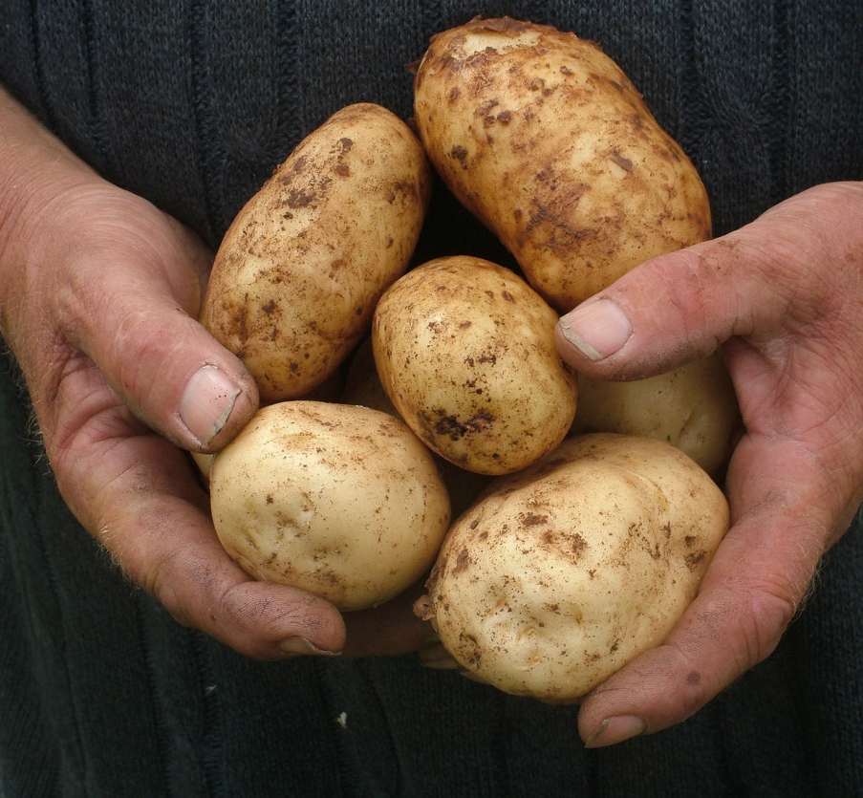
Reaping the Harvest
Look to eternity
Tear down your idols of desire
Desire Jesus
Desire Christlikeness

