Slide 1
Acts:
The Unhindered Harvest

Slide 2
The Thessalonian Letters
The Story of Acts
A sample of the harvest
Follow-up letters
An intimate look at…
Paul’s heart
Thessalonians faith

Slide 3
2nd Thessalonians 1:3-7
We ought always to give thanks to God for you, brethren, as is only fitting, because your faith is greatly enlarged,

Slide 4
and the love of each one of you toward one another grows ever greater; therefore, we ourselves speak proudly of you among the churches of God

Slide 5
for your perseverance and faith in the midst of all your persecutions and afflictions which you endure.

Slide 6
This is a plain indication of God’s righteous judgment so that you will be considered worthy of the kingdom of God, for which indeed you are suffering.

Slide 7
For after all it is only just for God to repay with affliction those who afflict you,

Slide 8
and to give relief to you who are afflicted and to us as well when the Lord Jesus will be revealed from heaven with His mighty angels in flaming fire,
New American Standard Bible : 1995 Update. LaHabra, CA : The Lockman Foundation, 1995

Slide 9
Some Context
A follow-up letter
First personal letter
Theme – now and later
Thanksgiving
Hope
Faithful living
Hope shapes life

Slide 10
Now and Later
Thanksgiving (1:1-4)
Growth
Perseverance
Hope (1:5-2:12)
God’s vengeance and glory
God’s time
God’s call

Slide 11
Now and Later
Hopeful Living (2:15-3:18)
Stand firm
Stand assured
Stand apart
Stand steadfast

Slide 12
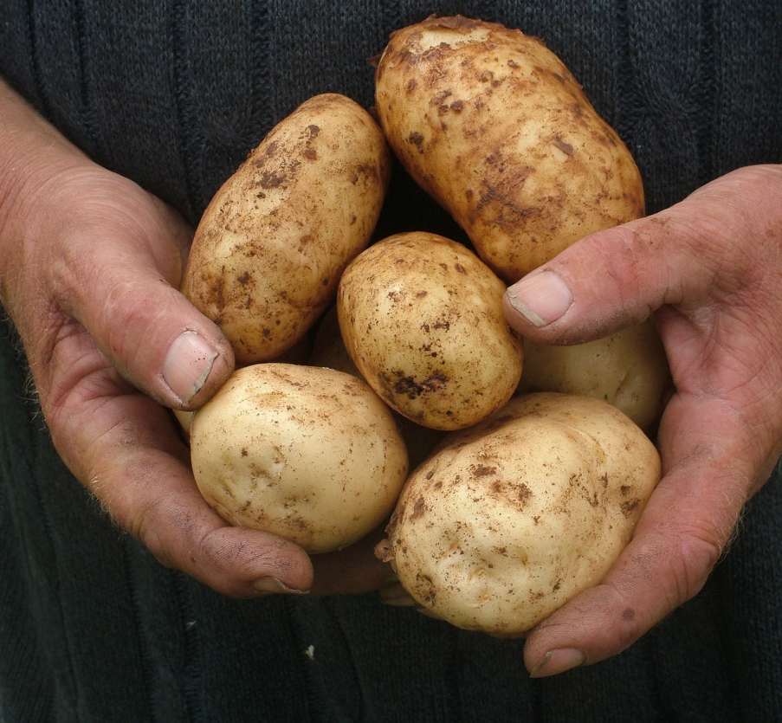
Reaping the Harvest
Don’t be a defeatist
Be assured
Be productive, not entertained
Be energized

