Slide 1
Acts:
The Unhindered Harvest

Slide 2
Who? ME?!
I’m not…
I can’t…
I don’t…
I’m good enough
I’m not good enough

Slide 3
Acts 18:24-28
Now a Jew named Apollos, an Alexandrian by birth, an eloquent man, came to Ephesus; and he was mighty in the Scriptures.

Slide 4
This man had been instructed in the way of the Lord; and being fervent in spirit, he was speaking and teaching accurately the things concerning Jesus,

Slide 5
being acquainted only with the baptism of John; and he began to speak out boldly in the synagogue.

Slide 6
But when Priscilla and Aquila heard him, they took him aside and explained to him the way of God more accurately.

Slide 7
And when he wanted to go across to Achaia, the brethren encouraged him and wrote to the disciples to welcome him;

Slide 8
and when he had arrived, he greatly helped those who had believed through grace,

Slide 9
for he powerfully refuted the Jews in public, demonstrating by the Scriptures that Jesus was the Christ.
New American Standard Bible : 1995 Update. LaHabra, CA : The Lockman Foundation, 1995

Slide 10
Apollos
Who?
What?
Huh?

Slide 12
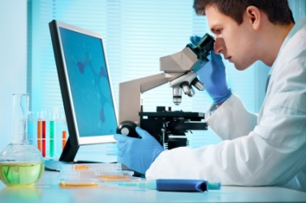
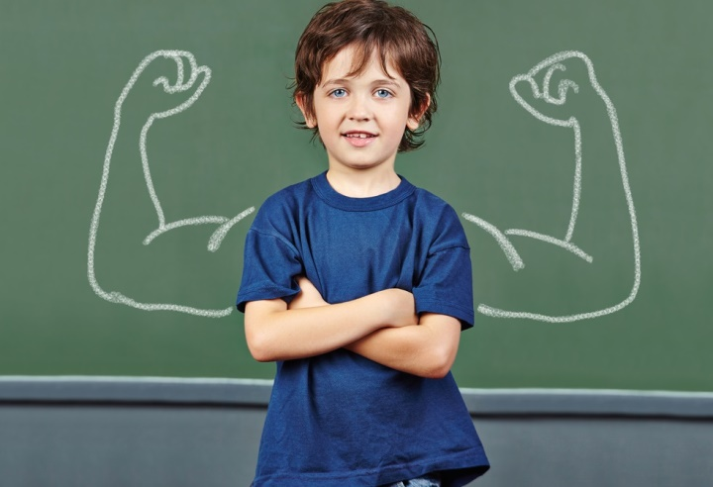
Apollos

Slide 13
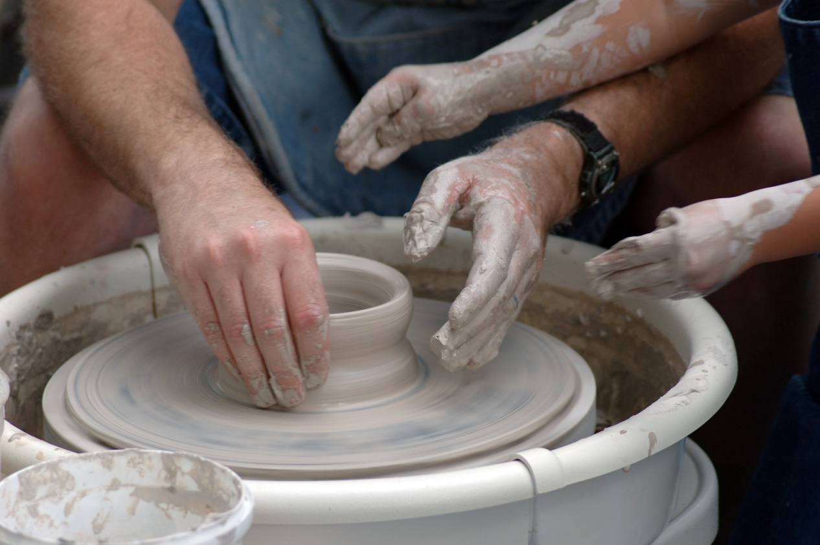
Apollos

Slide 14
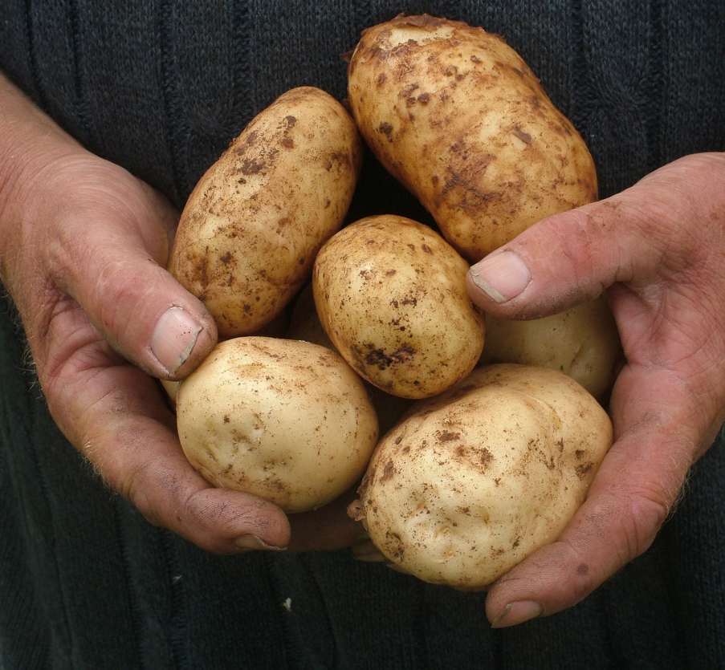
Reaping the Harvest
You are good enough in Christ
You are never finished
Be teachable

Slide 15
Communion
Jesus makes us capable
Jesus makes us acceptable

