Slide 1
Acts:
The Unhindered Harvest

Slide 2
Acts 19:11-15
God was performing extraordinary miracles by the hands of Paul,

Slide 3
so that handkerchiefs or aprons were even carried from his body to the sick, and the diseases left them and the evil spirits went out.

Slide 4
But also some of the Jewish exorcists, who went from place to place, attempted to name over those who had the evil spirits the name of the Lord Jesus, saying, “I adjure you by Jesus whom Paul preaches.”

Slide 5
Seven sons of one Sceva, a Jewish chief priest, were doing this. And the evil spirit answered and said to them, “I recognize Jesus, and I know about Paul, but who are you?”
New American Standard Bible : 1995 Update. LaHabra, CA : The Lockman Foundation, 1995

Slide 6
Ephesus
Heavily influenced by magic and cultic arts
In great decline
God was working greatly

Slide 7
God at Work
Extraordinary miracles
Crazy Stuff…TV Evangelist Stuff
Emphasis on God
Sovereign Intervention

Slide 8
God at Work
Context specific
Powerful picture for a specific people
Reminiscent of another moment in time

Slide 9
Frauds at Work
A picture of hypocrisy
“…they do not believe [the] gospel, yet they seek to tap into [its] power." (Bock, pg. 603)

Slide 10
Frauds at Work
Frauds exposed
Frauds embarrassed

Slide 11
Frauds at Work
Luke "...distinguishes miracle from magic in that magic seeks to manipulate the gods…whereas [a] miracle is God's sovereign act..." (Bock, pg. 602)

Slide 12
Frauds at Work
Prophetic of another moment in time

Slide 13
The Gospel at Work
Fear and glory
"Jesus is a power that cannot be controlled; He will not act as a lackey for anyone who calls on His name." (Peterson, pg. 540)

Slide 14
The Gospel at Work
Faith and repentance
Decisive
Costly
The Word of God continued to prevail

Slide 15
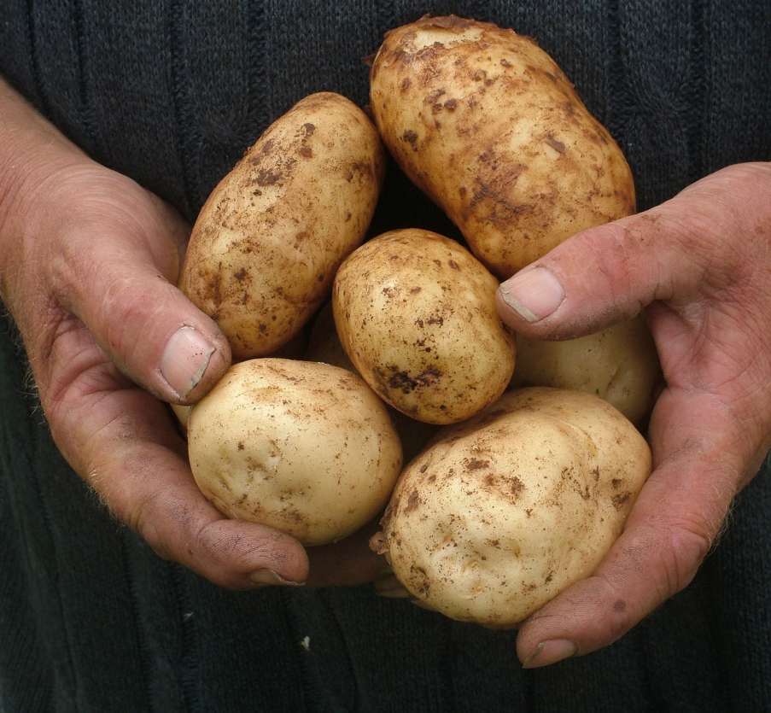
Reaping the Harvest
Don’t claim what isn’t yours to claim
No blessing without belief
Fear and repentance are friends

