Slide 1
Acts:
The Unhindered Harvest

Slide 2
Acts 19:23-28
About that time there occurred no small disturbance concerning the Way.

Slide 3
For a man named Demetrius, a silversmith, who made silver shrines of Artemis, was bringing no little business to the craftsmen;

Slide 4
these he gathered together with the workmen of similar trades, and said, “Men, you know that our prosperity depends upon this business.

Slide 5
“You see and hear that not only in Ephesus, but in almost all of Asia, this Paul has persuaded and turned away a considerable number of people, saying that gods made with hands are no gods at all.

Slide 6
“Not only is there danger that this trade of ours fall into disrepute, but also that the temple of the great goddess Artemis be regarded as worthless

Slide 7
and that she whom all of Asia and the world worship will even be dethroned from her magnificence.”

Slide 8
When they heard this and were filled with rage, they began crying out, saying, “Great is Artemis of the Ephesians!”
New American Standard Bible : 1995 Update. LaHabra, CA : The Lockman Foundation, 1995

Slide 9
Victory and Vision
No resting on their laurels
Mission means movement
No time for complacency

Slide 10
The War Rages On
Gospel Threats
Loss of revenue
Loss of reputation
Loss of significance

Slide 11
The War Rages On
“…the threat was economic, cultural, and religious." (Bock, pg. 609)
Gospel Chaos
Rage
Crazed Confusion

Slide 12
Surprising Interventions
Friends in high places
Enemies in high places

Slide 13
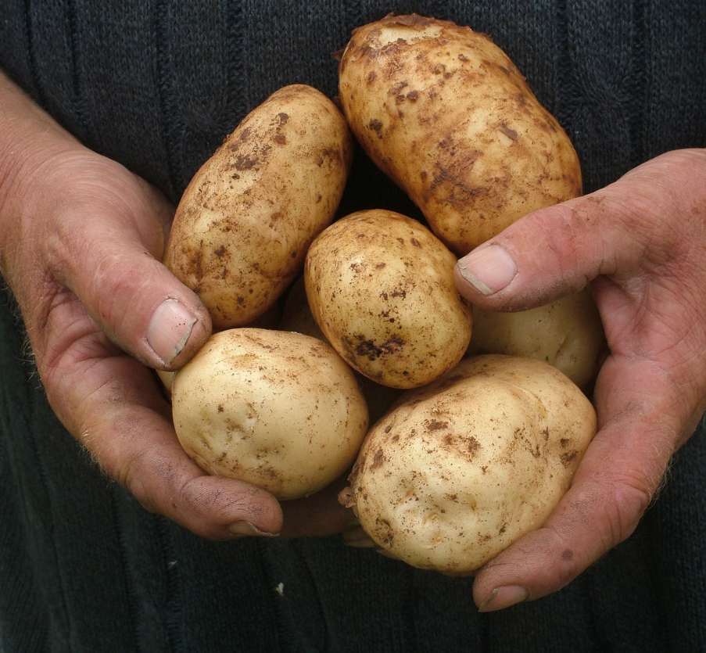
Reaping the Harvest
Focus on Christ
Focus on living for Christ
Don’t be shocked
Be careful with expectations

