Slide 1
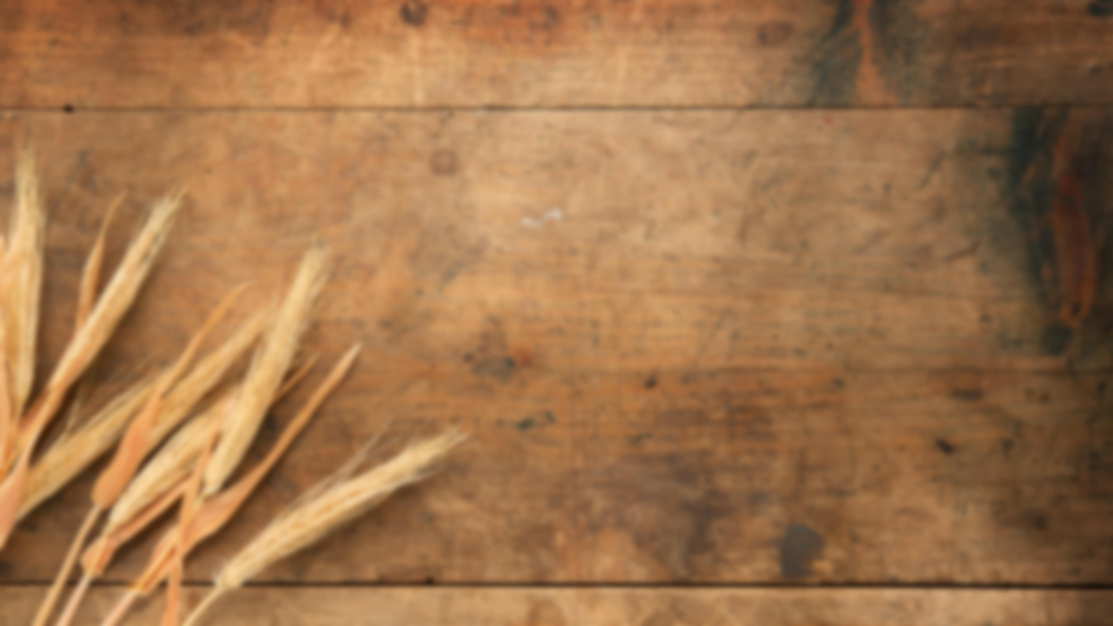
Acts:
The Unhindered Harvest

Slide 2

What are you thankful for?
Did you do this on Thursday?
We did...
  My family
  Living in Alaska
  Lighthouse Church
  And so many “things”

Slide 3
What are you thankful for?
I fear we have confused
  “Thankful for…”
  “Happy for…”
Something is missing
  “For” requires a “to”
  To whom do I give my “thanks”?

Slide 4
We must get this right!
An ungrateful person is an arrogant, entitled person
An ungrateful person is at odds with God
Genuine worship involves thankfulness

Slide 5
Psalm 100
Shout joyfully to the Lord, all the earth. Serve the Lord with gladness; Come before Him with joyful singing.

Slide 6
Know that the Lord Himself is God; It is He who has made us, and not we ourselves; We are His people and the sheep of His pasture.

Slide 7
Enter His gates with thanksgiving And His courts with praise. Give thanks to Him, bless His name.

Slide 8
For the Lord is good; His lovingkindness is everlasting And His faithfulness to all generations.
New American Standard Bible : 1995 Update. LaHabra, CA : The Lockman Foundation, 1995

Slide 9
Psalm 100
A Psalm for Thanksgiving
A “thanks-offering”
The first-fruits of our lips (Hebrews 13:15)

Slide 10
Psalm 100
God is the object
  “…to the Lord…” (vs. 1)
  “…to Him…” (vs. 4)

Slide 11
The Attitude of Gratitude
Joy (vss. 1 & 2)
Gladness (vs. 2)
Humility (vs. 2)
  “Serve…”
  “…come before…”

Slide 12
The Grounds for Gratitude
He is the Lord, He is God (vs. 3)
He is our Source (vs. 3)
He is our Owner (vs. 3)
He is our Provider (vs. 3)

Slide 13
The Grounds for Gratitude
He is good (vs. 5)
  Lovingkindness is everlasting
  Faithfulness to all generations

Slide 14

Reaping the Harvest
Focus more on the “who” than on the “what”
Gifts come from grace
Worship requires a thankful heart and mind

Slide 15
2 Corinthians 2:14
“…thanks be to God, who always leads us in triumph in Christ, and manifests through us the sweet aroma of the knowledge of Him in every place.

Slide 16
For we are a fragrance of Christ to God among those who are being saved and among those who are perishing…”
New American Standard Bible : 1995 Update. LaHabra, CA : The Lockman Foundation, 1995

