Slide 2
Christmas Longings
Peace
Harmony
Personal engagement
Joy (no matter the burdens)
Seems like everything fights against that

Slide 3
Romans 8:18-23
For I consider that the sufferings of this present time are not worthy to be compared with the glory that is to be revealed to us.

Slide 4
For the anxious longing of the creation waits eagerly for the revealing of the sons of God. For the creation was subjected to futility, not willingly, but because of Him who subjected it, in hope

Slide 5
that the creation itself also will be set free from its slavery to corruption into the freedom of the glory of the children of God. For we know that the whole creation groans and suffers the pains of childbirth together until now.

Slide 6
And not only this, but also we ourselves, having the first fruits of the Spirit, even we ourselves groan within ourselves, waiting eagerly for our adoption as sons, the redemption of our body.
New American Standard Bible : 1995 Update. LaHabra, CA : The Lockman Foundation, 1995

Slide 7
Creation and Struggle
Our experience…
Suffering
Futility
Corruption
Groaning

Slide 8
Creation and Struggle
Our sin-induced experience…
Enmity
Pain
Grief
Toil
Opposition

Slide 9
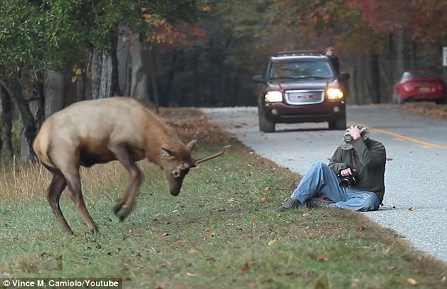
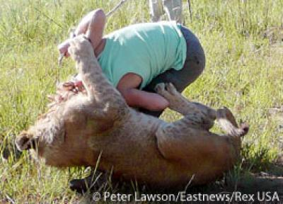
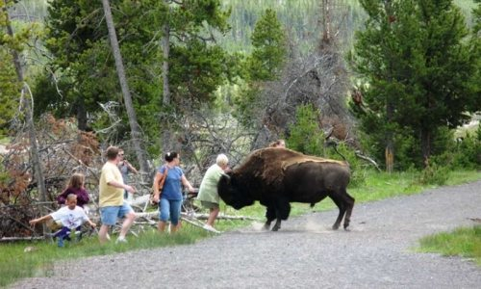
Struggle…Dangerous Dysfunction

Slide 10
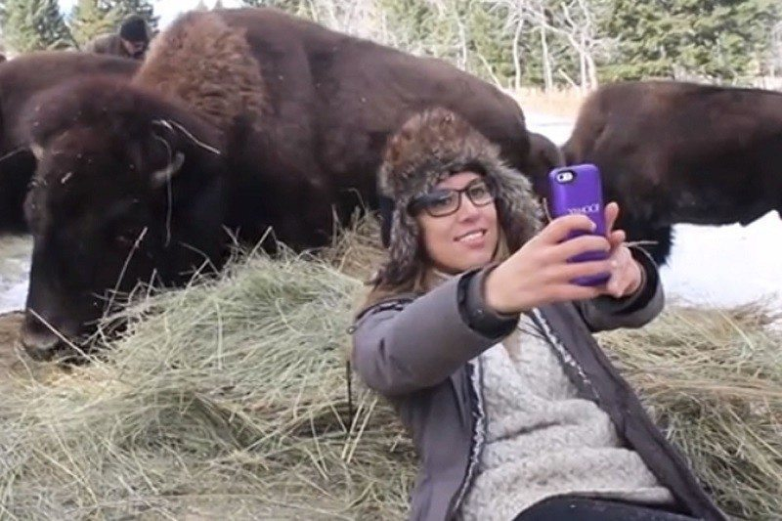
Struggle…Dangerous Dysfunction

Slide 11
Struggle…Dangerous Dysfunction
The struggle is real!
Created in the context of peace and harmony

Slide 12
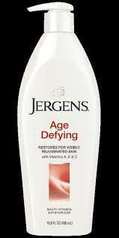
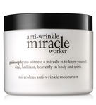
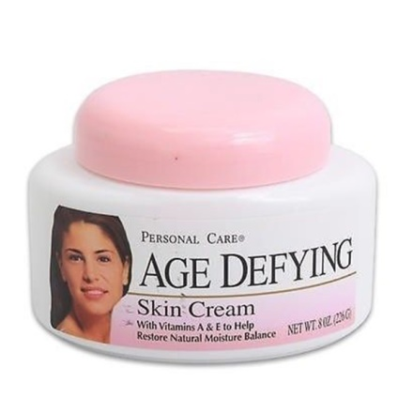
Struggle…Mortality

Slide 13
Struggle…Mortality

Slide 14
Struggle…Mortality
The struggle is real!
Created in context of eternity

Slide 15
The Hope of the Messiah
Glory
Life
Harmony

Slide 16
The Hope of the Messiah
Kingdom living…Eden glorified
Eden’s Relational Triad
Mankind to God
Mankind to Mankind
Mankind to Nature

Slide 17
1st John 3:1-3
See how great a love the Father has bestowed on us, that we would be called children of God; and such we are. For this reason the world does not know us, because it did not know Him.

Slide 18
Beloved, now we are children of God, and it has not appeared as yet what we will be. We know that when He appears, we will be like Him, because we will see Him just as He is.

Slide 19
And everyone who has this hope fixed on Him purifies himself, just as He is pure.
New American Standard Bible : 1995 Update. LaHabra, CA : The Lockman Foundation, 1995

