Slide 1
Acts:
The Unhindered Harvest

Slide 2
Back in Acts!
The Unhindered Harvest (28:30-31)
God’s Plan (Matthew 28:18-20)
God’s Assurance (1:8)

Slide 3
Back in Acts!
Flow of Acts
Disciples
Peter
Paul

Slide 4
Back in Acts!
Paul on the move
3rd journey
Strengthening churches (15:36)
Heading to Jerusalem (19:21, 20:16, Romans 15:25-27)

Slide 5
Back in Acts!
The Storyline
Risen Christ ascended
The Holy Spirit descended
Gospel spread in spite of opposition
Imminent danger…sleep

Slide 6
Acts 20:7-12
On the first day of the week, when we were gathered together to break bread,

Slide 7
Paul began talking to them, intending to leave the next day, and he prolonged his message until midnight.

Slide 8
There were many lamps in the upper room where we were gathered together. And there was a young man named Eutychus sitting on the window sill, sinking into a deep sleep;

Slide 9
and as Paul kept on talking, he was overcome by sleep and fell down from the third floor and was picked up dead.

Slide 10
But Paul went down and fell upon him, and after embracing him, he said, “Do not be troubled, for his life is in him.”

Slide 11
When he had gone back up and had broken the bread and eaten, he talked with them a long while until daybreak, and then left.

Slide 12
They took away the boy alive, and were greatly comforted.
New American Standard Bible : 1995 Update. LaHabra, CA : The Lockman Foundation, 1995

Slide 13
Sleep? Paul?!
People and places
Paul’s heart
Verifiable history
Two intense events
Seemingly unrelated
Both uniquely emotional

Slide 14
Sleeping can be fatal!
In a room with people
A well lit room
Precariously perched
Paul teaching
Sleep came slowly
Sleep come suddenly
Fell to his death

Slide 15
Get the picture?!

Slide 16
Call to Wakefulness
Leaders of the church at Ephesus
Poignant and powerful meeting…last one!
Two instructions
Be on guard
Be alert

Slide 17
Call to Wakefulness
Be on guard
Be attentive
Be devoted
Be Addicted
Ship coming into harbor

Slide 18
Call to Wakefulness
Yourself and others
Wolves
Destruction from within
Slowly deceptive
Drawing away from Christ

Slide 19
Call to Wakefulness
Be alert
Vigilant
Watchful
To be fully awake
To prevent or avoid calamity

Slide 20
Get the picture?!

Slide 21
Call to Wakefulness
Narrative isn’t merely a running chronology
Concern is never mere history
Unconnected events connected for the readers benefit

Slide 22
How to stay awake
Paul’s example
Engage with people
Committed to the Bible
Heart of repentance
Know our place
An eternal perspective

Slide 23
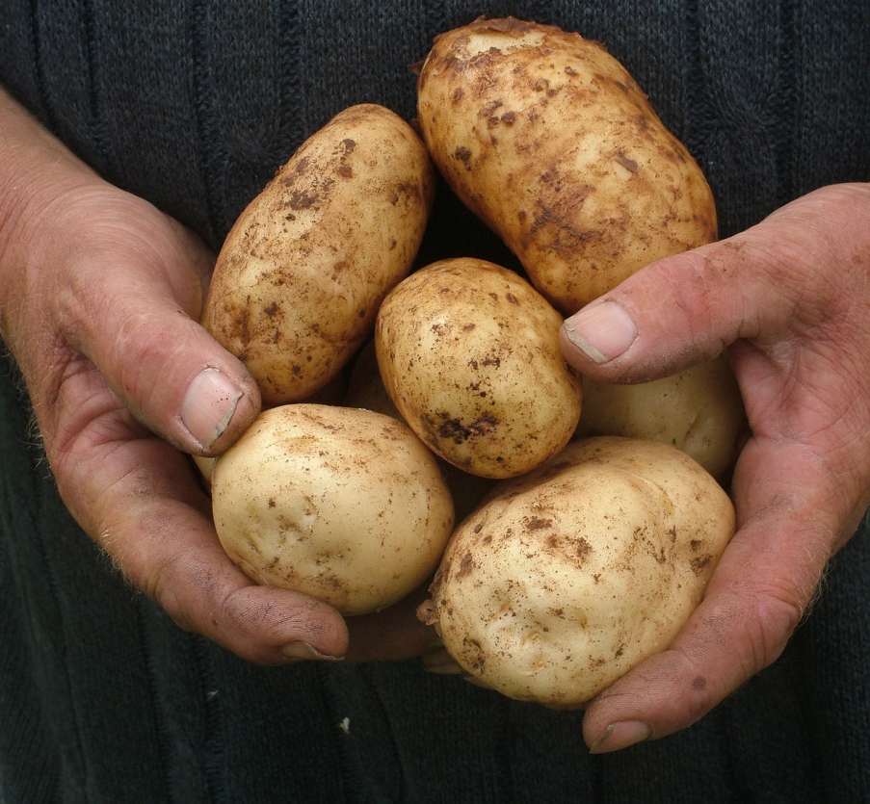
Reaping the Harvest
Being in the light and being taught are never enough
Take responsibility
For yourself
For the body

