Slide 1
Acts:
The Unhindered Harvest

Slide 2
The Acts Storyline
The Unhindered Harvest (28:30-31)
The historical record
The facts
The manner

Slide 3
The Acts Storyline
Encouragement
Understanding
Role of our testimony
Role of our attitude
Role as a servant

Slide 4
Acts 21:10-14
As we were staying there for some days, a prophet named Agabus came down from Judea.

Slide 5
And coming to us, he took Paul’s belt and bound his own feet and hands, and said, “This is what the Holy Spirit says:

Slide 6
‘In this way the Jews at Jerusalem will bind the man who owns this belt and deliver him into the hands of the Gentiles.’ ”

Slide 7
When we had heard this, we as well as the local residents began begging him not to go up to Jerusalem.

Slide 8
Then Paul answered, “What are you doing, weeping and breaking my heart? For I am ready not only to be bound, but even to die at Jerusalem for the name of the Lord Jesus.”

Slide 9
And since he would not be persuaded, we fell silent, remarking, “The will of the Lord be done!”
New American Standard Bible : 1995 Update. LaHabra, CA : The Lockman Foundation, 1995

Slide 10
The Servant Submits
No matter the path
The path of suffering
20:22-24
21:4
21:11
1st Peter 4:12-19

Slide 11
The Servant Submits
Suffering even to death
Steadfast conviction

Slide 12
The Servant and Gossip
Suffering in the Body
Inhibits trust
Instills fear
Why it happens
Product of jealousy
Gives us influence
Gore amid the glory

Slide 13
The Servant and Gossip
Handle with humility
Concern was not about “self”
Concern was about the gospel

Slide 14
The Servant and Unjust Suffering
Same accusation
Physical rather than emotional
Dragged away
Sought to kill him
Put in chains

Slide 15
The Servant and Unjust Suffering
Handle with humility
Concern was not about “self”
Concern was about the gospel
Appealed to the law

Slide 16
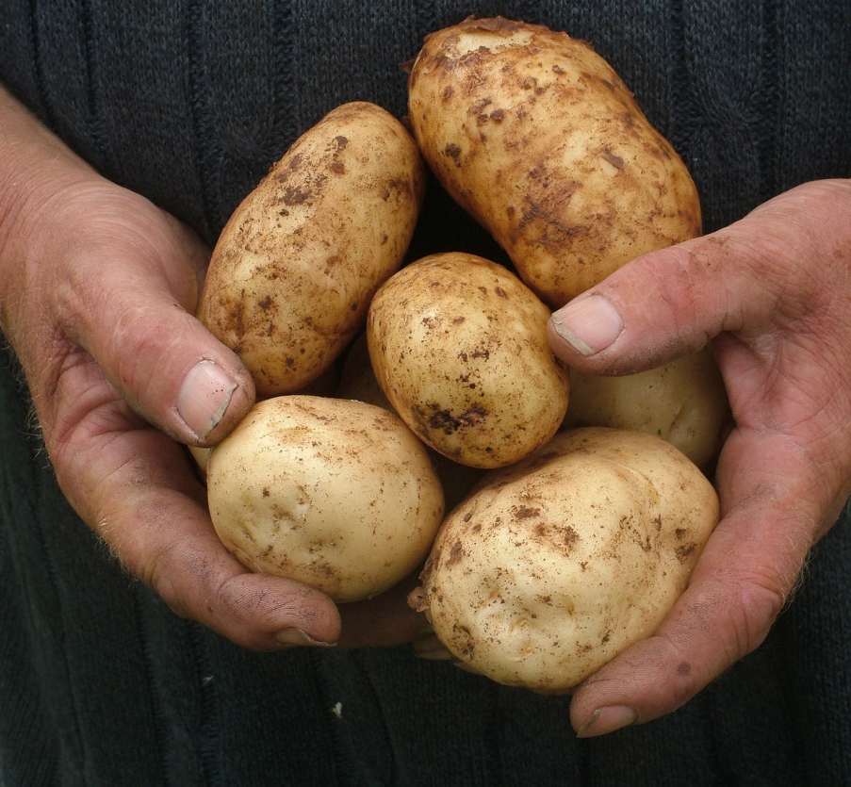
Reaping the Harvest
A servant submits
A servant is not about “self”
The gospel is our manifesto

