Slide 1

Acts:
The Unhindered Harvest

Slide 2

The Acts Storyline
The Unhindered Harvest (28:30-31)
An historical record
An exemplary record
  Life
  Ministry
  Fellowship

Slide 3
Celebration & Memorial
Normative for God’s people
  Passover & Unleavened bread
  The Lord’s Supper
Acts of deliverance

Slide 4
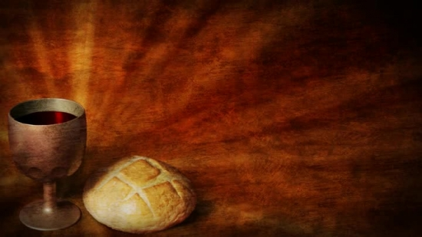
1st Corinthians 11:23-29
For I received from the Lord that which I also delivered to you, that the Lord Jesus in the night in which He was betrayed took bread;

Slide 5
and when He had given thanks, He broke it and said, “This is My body, which is for you; do this in remembrance of Me.”

Slide 6
In the same way He took the cup also after supper, saying, “This cup is the new covenant in My blood; do this, as often as you drink it, in remembrance of Me.”

Slide 7
For as often as you eat this bread and drink the cup, you proclaim the Lord’s death until He comes.

Slide 8
Therefore whoever eats the bread or drinks the cup of the Lord in an unworthy manner, shall be guilty of the body and the blood of the Lord.

Slide 9
But a man must examine himself, and in so doing he is to eat of the bread and drink of the cup.

Slide 10
For he who eats and drinks, eats and drinks judgment to himself if he does not judge the body rightly.
New American Standard Bible : 1995 Update. LaHabra, CA : The Lockman Foundation, 1995

Slide 11
The Elements
Repentance
  Turn from sin to Christ
  Examine yourself
Foundational
  Mark 1:4 &15, 6:12
  Luke 24:45-47
  Acts 20:21

Slide 12
The Elements
The Bread
  The body of Jesus
  The life of Jesus
  The victory of Jesus
  Live accordingly (Acts 20:28)
  Celebrate accordingly

Slide 13
The Elements
The Cup
  The New Covenant
  The blood of Christ
  The purchase price (Acts 20:28)
  Celebrate accordingly

