Slide 1
Acts:
The Unhindered Harvest

Slide 2
The Acts Storyline
The Unhindered Harvest (28:30-31)
God’s story
Not man’s story
Not Paul’s story

Slide 3
Acts 23:10-13
And as a great dissension was developing, the commander was afraid Paul would be torn to pieces by them

Slide 4
and ordered the troops to go down and take him away from them by force, and bring him into the barracks.

Slide 5
But on the night immediately following, the Lord stood at his side and said, “Take courage; for as you have solemnly witnessed to My cause at Jerusalem, so you must witness at Rome also.”

Slide 6
When it was day, the Jews formed a conspiracy and bound themselves under an oath, saying that they would neither eat nor drink until they had killed Paul.

Slide 7
There were more than forty who formed this plot.
New American Standard Bible : 1995 Update. LaHabra, CA : The Lockman Foundation, 1995

Slide 8
Paul’s Predicament
Attacked by a Jewish mob (Ch. 21)
Arrested by the Romans (Ch. 21)
Continual threat of violence (23:2, 12-15)

Slide 9
Paul’s Predicament
Religious charges (23:6; 24:17-21; 25:19)
Criminal charges (24:5; cf. 21:38)

Slide 10
Paul’s Response
He was humble (23:4-5)
He was at peace (24:10-21)
He didn’t waver (24:24-27; 26:19-23)

Slide 11
God’s Response
Gave assurance (23:11)
Kept him locked up (23:10, 35; 24:22-27)
Allowed accusations to continue (chs. 24-25)
Sustained him (23:16-22; 24:23)

Slide 12
God’s Response
Provided platform to be a witness
To the Jews
To government officials
Felix (ch. 24)
Festus (ch. 25)
Agrippa (ch. 26)

Slide 13
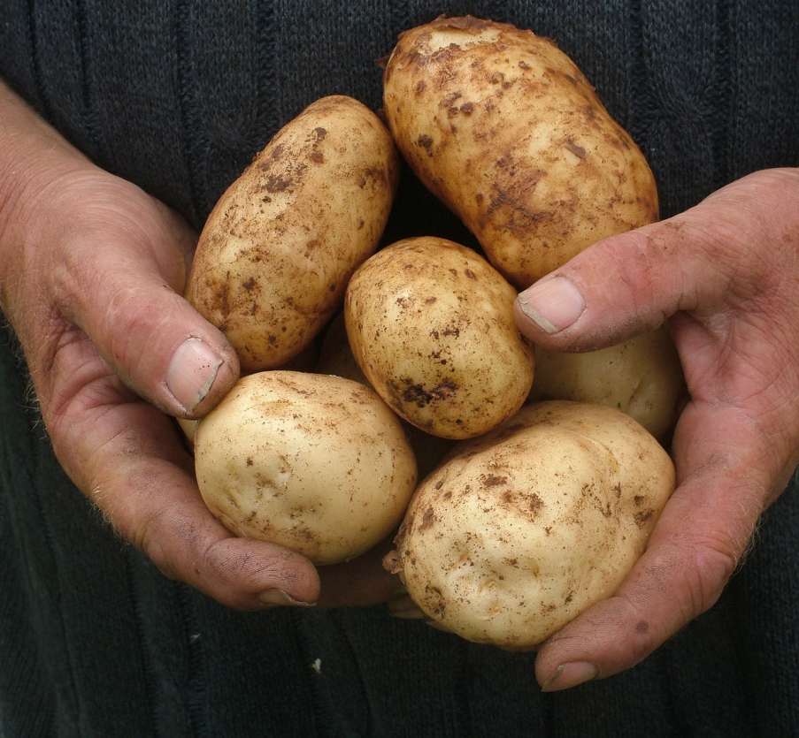
Reaping the Harvest
Manage our expectations
It’s all about “purpose”
Sustenance not comfort

