Slide 1
Acts:
The Unhindered Harvest

Slide 2
The Gospel
Good news
Forgiveness
Reconciliation
New Life
Thru the work of Christ

Slide 3
The Gospel
Does it work?
No…REALLY work
How’s the success rate?
Would it make the Hall of Fame?
Would it keep you employed?

Slide 4
The Gospel
It seems like a failure
We need to understand the fullness of what the gospel does.

Slide 5
Acts 26:19-23
“So, King Agrippa, I did not prove disobedient to the heavenly vision, but kept declaring both to those of Damascus first, and also at Jerusalem and then throughout all the region of Judea,

Slide 6
and even to the Gentiles, that they should repent and turn to God, performing deeds appropriate to repentance.

Slide 7
“For this reason some Jews seized me in the temple and tried to put me to death.

Slide 8
“So, having obtained help from God, I stand to this day testifying both to small and great, stating nothing but what the Prophets and Moses said was going to take place;

Slide 9
that the Christ was to suffer, and that by reason of His resurrection from the dead He would be the first to proclaim light both to the Jewish people and to the Gentiles.”
New American Standard Bible : 1995 Update. LaHabra, CA : The Lockman Foundation, 1995

Slide 10
The Current Storyline
Paul under arrest
Heading to Rome
Proclaiming Christ to Roman officials
Currently Festus and Agrippa II

Slide 11
The Current Storyline
Festus
Governor of Caesarea
Newly installed
Not fully versed in Jewish culture and religion
Needed Agrippa’s help

Slide 12
The Current Storyline
Agrippa II – ruler of northern Palestine
Great grandfather was Herod the Great
Great uncle was Herod Antipas
Father was Agrippa I

Slide 13
The Message
Repentance
In response to the vision
In response to the OT
Death of Jesus
Resurrection of Jesus
Light to the world

Slide 14
The Message
“Light” – is the key
Gives awareness and understanding
Light exposes and reveals
John 1:4-13
John 3:19-21

Slide 15
The Message
Darkness
Spiritual blindness
Spiritual lifelessness
Light reveals the condition of the heart
Light establishes judgment

Slide 16
Reactions to the Light
Festus – open rejection
Culturally repulsive
Utter foolishness
Agrippa – avoidance
Religious contradiction
No response is a response

Slide 17
Gospel Light
The gospel worked!
Opened blind eyes
Revealed condition of the heart

Slide 18
The Irony of it all
They saw Paul a prisoner who could’ve been free
They ignored their own shackles and rejected their chance to be free

Slide 19
The Irony of it all
They held onto human blamelessness
They rejected the blamelessness of Jesus

Slide 20
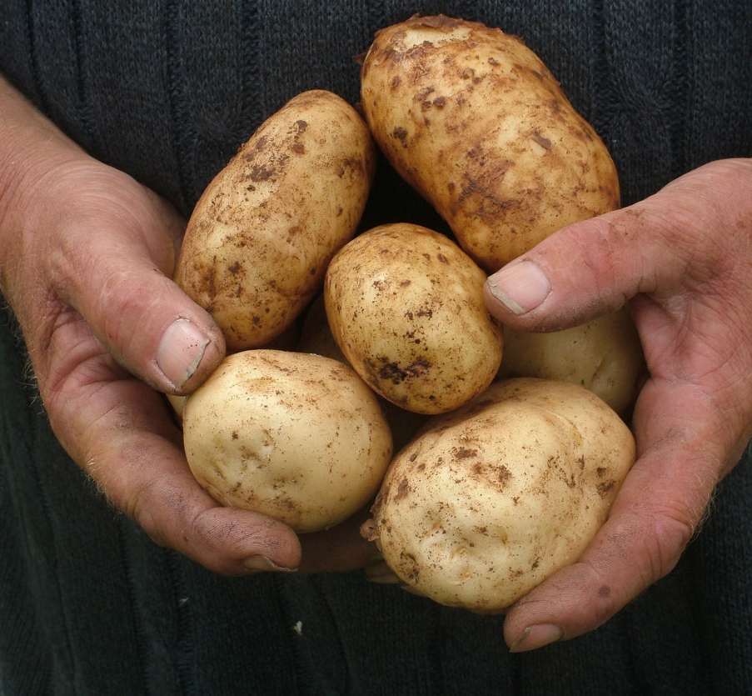
Reaping the Harvest
The gospel always works
The gospel will get a response
The gospel will provoke the heart

