Slide 1
Acts:
The Unhindered Harvest

Slide 2
Acts…The END!
April 23, 2017
22 months
About 96 weeks
One stage of our journey is over, another begins.
We must be unhindered

Slide 3
Acts 28:23-28
When they had set a day for Paul, they came to him at his lodging in large numbers; and he was explaining to them by solemnly testifying about the kingdom of God

Slide 4
and trying to persuade them concerning Jesus, from both the Law of Moses and from the Prophets, from morning until evening. Some were being persuaded by the things spoken, but others would not believe.

Slide 5
And when they did not agree with one another, they began leaving after Paul had spoken one parting word, “The Holy Spirit rightly spoke through Isaiah the prophet to your fathers,

Slide 6
saying, ‘Go to this people and say, “You will keep on hearing, but will not understand; And you will keep on seeing, but will not perceive;

Slide 7
For the heart of this people has become dull, And with their ears they scarcely hear, And they have closed their eyes;

Slide 8
Otherwise they might see with their eyes, And hear with their ears, And understand with their heart and return, And I would heal them.” ’

Slide 9
“Therefore let it be known to you that this salvation of God has been sent to the Gentiles; they will also listen.”
New American Standard Bible : 1995 Update. LaHabra, CA : The Lockman Foundation, 1995

Slide 10
The Unhindered Servant
Not hindered by hindrances
Delay and disaster
Chains
Inconveniences

Slide 11
The Unhindered Servant
Not hindered by an attitude
Past experiences
Presumption and assumption
Apathy

Slide 12
The Unhindered Servant
Not hindered by rejection
Know the truth
Faith in God
Trust His word
Joy in serving Jesus

Slide 13
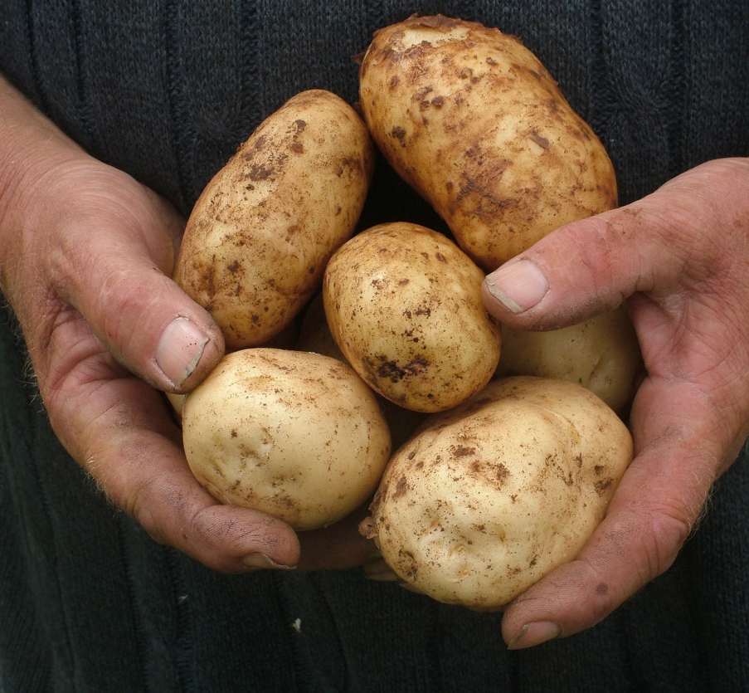
Reaping the Harvest
Our resolve must be bigger than our hindrances
Our faith must be bigger than our obstacles

