Slide 1

Acts:
The Unhindered Harvest

Slide 2

Acts…SO WHAT?!
It’s history
It’s a great testimony
It’s our heritage
But…
  SO WHAT?!

Slide 3
Acts 1:4-8
Gathering them together, He commanded them not to leave Jerusalem, but to wait for what the Father had promised, “Which,” He said, “you heard of from Me;

Slide 4
for John baptized with water, but you will be baptized with the Holy Spirit not many days from now.”

Slide 5
So when they had come together, they were asking Him, saying, “Lord, is it at this time You are restoring the kingdom to Israel?”

Slide 6
He said to them, “It is not for you to know times or epochs which the Father has fixed by His own authority

Slide 7
but you will receive power when the Holy Spirit has come upon you;

Slide 8
and you shall be My witnesses both in Jerusalem, and in all Judea and Samaria, and even to the remotest part of the earth.”
New American Standard Bible : 1995 Update. LaHabra, CA : The Lockman Foundation, 1995

Slide 9
The Main Character
Not Christian All-Stars
The Holy Spirit
Mentioned 70 times in 28 chapters

Slide 10
The Storyline
God and Sinners
  God saving sinners
  God empowering saved sinners
  God using saved sinners to accomplish His purposes

Slide 11
The Storyline
External Hindrances
  Religious persecution
  Political persecution
  Spiritual indifference
  Cultural pressure
  Extended inconveniences

Slide 12
The Storyline
Internal Hindrances
  Sin
  Division
  Human neediness
No hindrance hindered
All hindrances turned into a witness

Slide 13
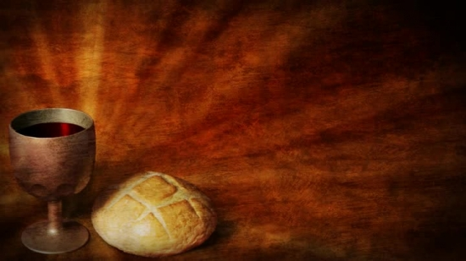
Communion
Celebrating Communion Compels
Assurance of Victory
On the cross all hindrances defeated

Slide 14
The Bread
The Body of Jesus
Jesus defeated sin
The enemy inside
The enemy outside

Slide 15
The Cup
The Blood of Jesus
Promise fulfilled
Persecution unable
Politics unable
Culture unable
Nothing stopped Him

Slide 16
The Story Goes On
Story never ended
Same storyline
Same main character
Different sinners
  Me
  You

Slide 17
Acts 28:30-31
And he stayed two full years in his own rented quarters and was welcoming all who came to him,

Slide 18
preaching the kingdom of God and teaching concerning the Lord Jesus Christ with all openness, unhindered.
New American Standard Bible : 1995 Update. LaHabra, CA : The Lockman Foundation, 1995

