Slide 1


Slide 2
The Headwaters
Have tremendous effect on stream integrity
Instrumental in the chemical and biological stability

Slide 3
The Headwaters
“The account opens with a clear, concise statement about the Creator and the Creation. Its simplicity belies the depth of its content. These…are the foundation of all that is to follow in the Bible.” (Sailhammer, Expositor’s)

Slide 4
Genesis 1:26-31
Then God said, “Let Us make man in Our image, according to Our likeness; and let them rule over the fish of the sea and over the birds of the sky and over the cattle and over all the earth, and over every creeping thing that creeps on the earth.”

Slide 5
God created man in His own image, in the image of God He created him; male and female He created them. God blessed them; and God said to them,

Slide 6
“Be fruitful and multiply, and fill the earth, and subdue it; and rule over the fish of the sea and over the birds of the sky and over every living thing that moves on the earth.”

Slide 7
Then God said, “Behold, I have given you every plant yielding seed that is on the surface of all the earth, and every tree which has fruit yielding seed; it shall be food for you;

Slide 8
and to every beast of the earth and to every bird of the sky and to every thing that moves on the earth which has life, I have given every green plant for food”; and it was so.

Slide 9
God saw all that He had made, and behold, it was very good. And there was evening and there was morning, the sixth day.
New American Standard Bible : 1995 Update. LaHabra, CA : The Lockman Foundation, 1995

Slide 10
God’s Revelation in Creation
God revealed Himself generally
  His attributes
  His divine power
God revealed Himself specifically
  His image as Sovereign Lord
  His image as Creator

Slide 11
God as Creator
He provides
He cares
He instructs and commands

Slide 12
As His Image
We are His servants
We are to serve His will
We are to serve His purposes

Slide 13
As His Image
We are to provide for
We are to give care to
We are to fill the earth
We are to bring into subjection
All in relation to our Creator

Slide 14
A Distorted Image
Mankind rebelled against subjection to its Creator
Mankind abandoned its purpose
Mankind no longer functions as the image of God

Slide 15
Jesus Restores the Image of God
Jesus – God with us (Matthew 1:23)
Jesus – The Servant of the Lord
  Isaiah 42:1-4
  Isaiah 52:13-53:12
Jesus – Fruitful and fills the earth
  Matthew 13:31-32
  Revelation 7:9

Slide 16
Jesus Restores the Image of God
Jesus, the second Adam, came to restore the image of God
Jesus had to come in the image of man to restore man to the image of God

Slide 17
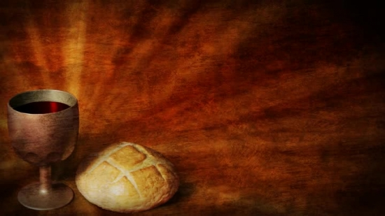
The Bread
The Body of Jesus
The faithful Servant
Victor over sin
He did what Adam could not

Slide 18
The Cup
The New Covenant
Jeremiah 31:33
Reconciles
Forgiveness
Law within us

