Slide 1
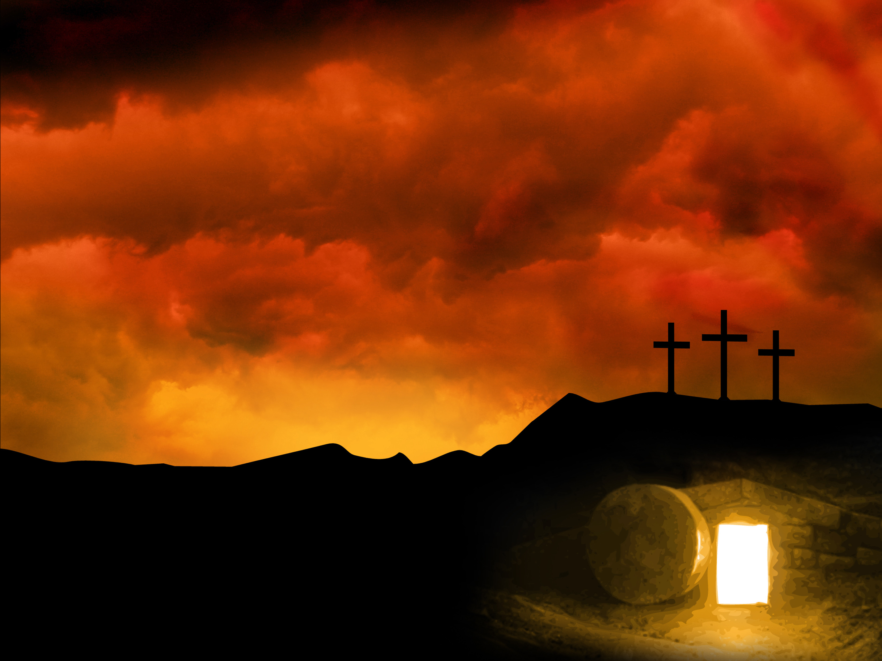
Happy Easter!
Friday…Jesus died
Sunday…Jesus raised
A fact well-attested
Not trying to prove
Just want to answer…
SO WHAT?!

Slide 2
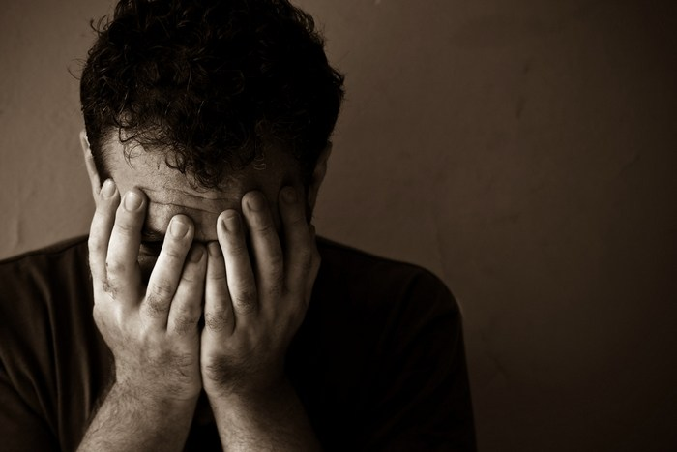
When we last saw Peter…
He had been to the top
He fell hard and fast
He had a complete meltdown
In full public view

Slide 3
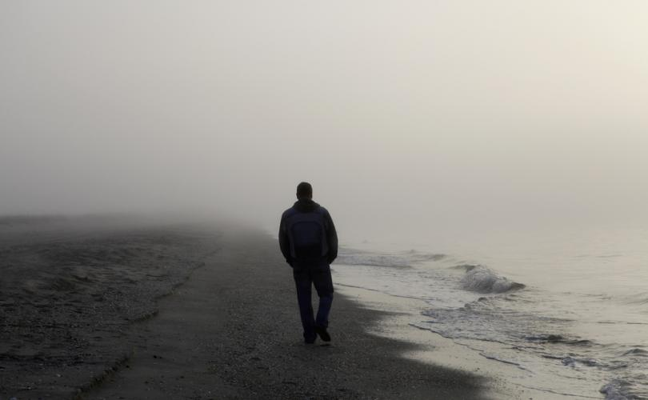
Peter…now what?
Can you imagine…
  The shame
  The embarrassment
  The lostness
  The loneliness

Slide 4
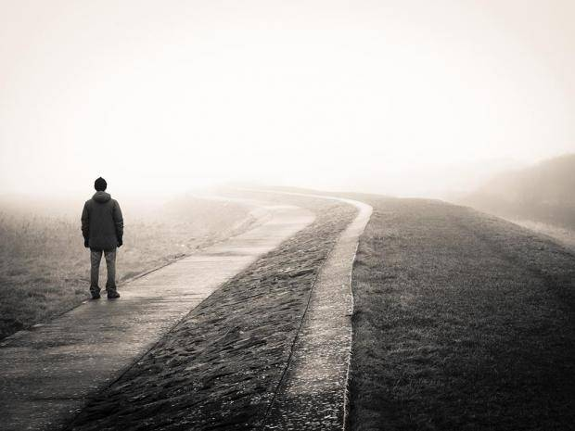
Peter…now what?
Hope was gone (Luke 24:13-21)
Fear had taken hold (John 20:19)
Reality and truth did not connect (John 20:8-9)
Going back was all that made sense (John 21:2-3)

Slide 5
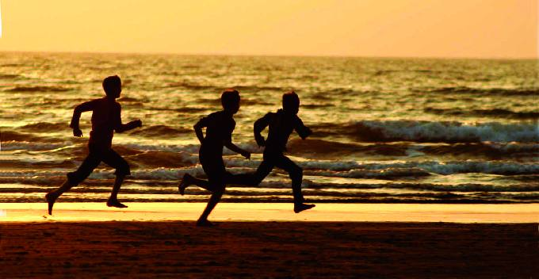
And then…Jesus
A revelation
Restoration of fellowship
Restoration of relationship
Realization of reality

Slide 6
The Resurrection
Gives us life and hope
Assures of our standing
Gives us joy
For those who truly believe
Will you love Him “more than these?” (John 21:15)

