Slide 1
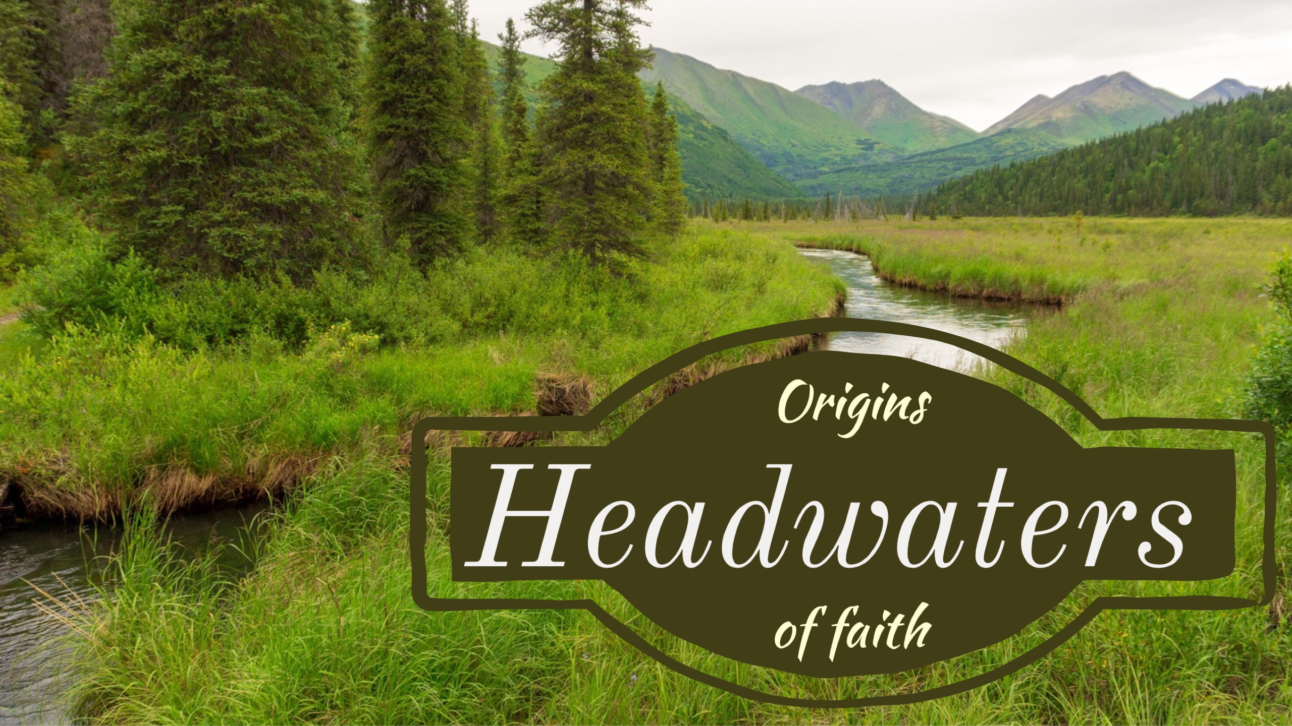

Slide 2
The Headwaters
God’s revelation of Himself
  His character
  His attributes
Not about proving but displaying
God’s revelation of His image
God’s revelation of purpose

Slide 3
The Headwaters
Our Purpose
  To serve and obey
  To do so as His image
Our Purpose
  Rule…flora and fauna
  Subdue…off-spring

Slide 4
The Headwaters
Subdue
  Bring into subjection
  Bring into bondage
  To keep under
To the Creator
  His will
  His instruction

Slide 5
The Headwaters
As His image it is our primary responsibility to bring children into subjection to the Creator, the Lord.
To that end…Psalm 78

Slide 6
Psalm 78:1-7
Listen, O my people, to my instruction; incline your ears to the words of my mouth. I will open my mouth in a parable; I will utter dark sayings of old, which we have heard and known, and our fathers have told us.

Slide 7
We will not conceal them from their children, but tell to the generation to come the praises of the Lord, and His strength and His wondrous works that He has done.

Slide 8
For He established a testimony in Jacob And appointed a law in Israel, which He commanded our fathers that they should teach them to their children,

Slide 9
That the generation to come might know, even the children yet to be born, that they may arise and tell them to their children,

Slide 10
That they should put their confidence in God and not forget the works of God, but keep His commandments,
New American Standard Bible : 1995 Update. LaHabra, CA : The Lockman Foundation, 1995

Slide 11
Who’s watching the kids???
The nation – the community of God’s people
Parents
Grandparents
No exclusions

Slide 12
The Command to us All
Hear and heed instruction
  The parable and dark sayings
  The riddles and enigmas of life
Understand it
Reveal it
What is it? (vss. 9-72)

Slide 13
“…those matters of history which are so hard to understand: the unyielding stubbornness of God’s people over against His unwavering faithfulness.

Slide 14
How can…people spurn such grace? How can God continue to manifest such longsuffering? These are the great enigmas of history.” (Leupold, pp. 563-564)

Slide 15
What is the curriculum?
The praises of God
  His attributes, His greatness
  His works
The Law of God
  The necessity of obedience
  The need for a Savior
The image of God

Slide 16
What is the goal?
Confidence in God
Remember God
Obey God
To not repeat history
  Hearts prepared to obey
  Life set on faithfulness

Slide 17
Where do the waters flow?
As God’s people we need to be generationally driven
Not about influence, it’s about content. What are you teaching?
Kids don’t need to know how great they are, they need to know how great God is.

Slide 18
Where do the waters flow?
It’s not about raising nice kids, but about God-honoring kids
It’s about teaching kids that life is not about them, but about God

