Slide 1
Happy Father’s Day
God, the Creator
God the Father
Our head
Our source
Provider
Protector
Disciplinarian

Slide 2
Happy Father’s Day
The headwaters flow from a father and child
A childless couple
A promised son
A miraculous birth

Slide 3
Genesis 15:2-6
Abram said, “O Lord God, what will You give me, since I am childless, and the heir of my house is Eliezer of Damascus?” And Abram said, “Since You have given no offspring to me, one born in my house is my heir.”

Slide 4
Then behold, the word of the Lord came to him, saying, “This man will not be your heir; but one who will come forth from your own body, he shall be your heir.”

Slide 5
And He took him outside and said, “Now look toward the heavens, and count the stars, if you are able to count them.” And He said to him, “So shall your descendants be.” Then he believed in the Lord; and He reckoned it to him as righteousness.
New American Standard Bible : 1995 Update. LaHabra, CA : The Lockman Foundation, 1995

Slide 6
Genesis 18:10-14
He said, “I will surely return to you at this time next year; and behold, Sarah your wife will have a son.” And Sarah was listening at the tent door, which was behind him.

Slide 7
Now Abraham and Sarah were old, advanced in age; Sarah was past childbearing. Sarah laughed to herself, saying, “After I have become old, shall I have pleasure, my lord being old also?”

Slide 8
And the Lord said to Abraham, “Why did Sarah laugh, saying, ‘Shall I indeed bear a child, when I am so old?’ “Is anything too difficult for the Lord? At the appointed time I will return to you, at this time next year, and Sarah will have a son.”
New American Standard Bible : 1995 Update. LaHabra, CA : The Lockman Foundation, 1995

Slide 9
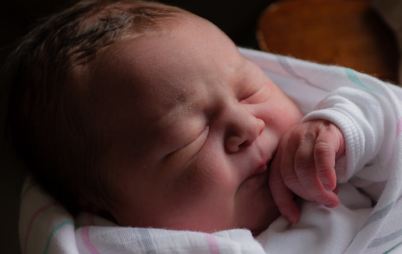
It begins with a child
The Promise
A great nation
A great blessing
The Hope
An heir
A child
A son

Slide 10
The Promise and Hope
In the fullness of time
God will send forth a son
A miraculous birth
Bringing life from death
Under the shadow of death

Slide 11
Where do the waters flow?
God’s promise is fulfilled in the birth of His Son
God’s promised blessing is fulfilled in the death of His Son
The pools of response
Faith
Dismissal or mocking

Slide 12
John 3:16
“For God so loved the world, that He gave His only begotten Son, that whoever believes in Him shall not perish, but have eternal life.”
New American Standard Bible : 1995 Update. LaHabra, CA : The Lockman Foundation, 1995

