Slide 1
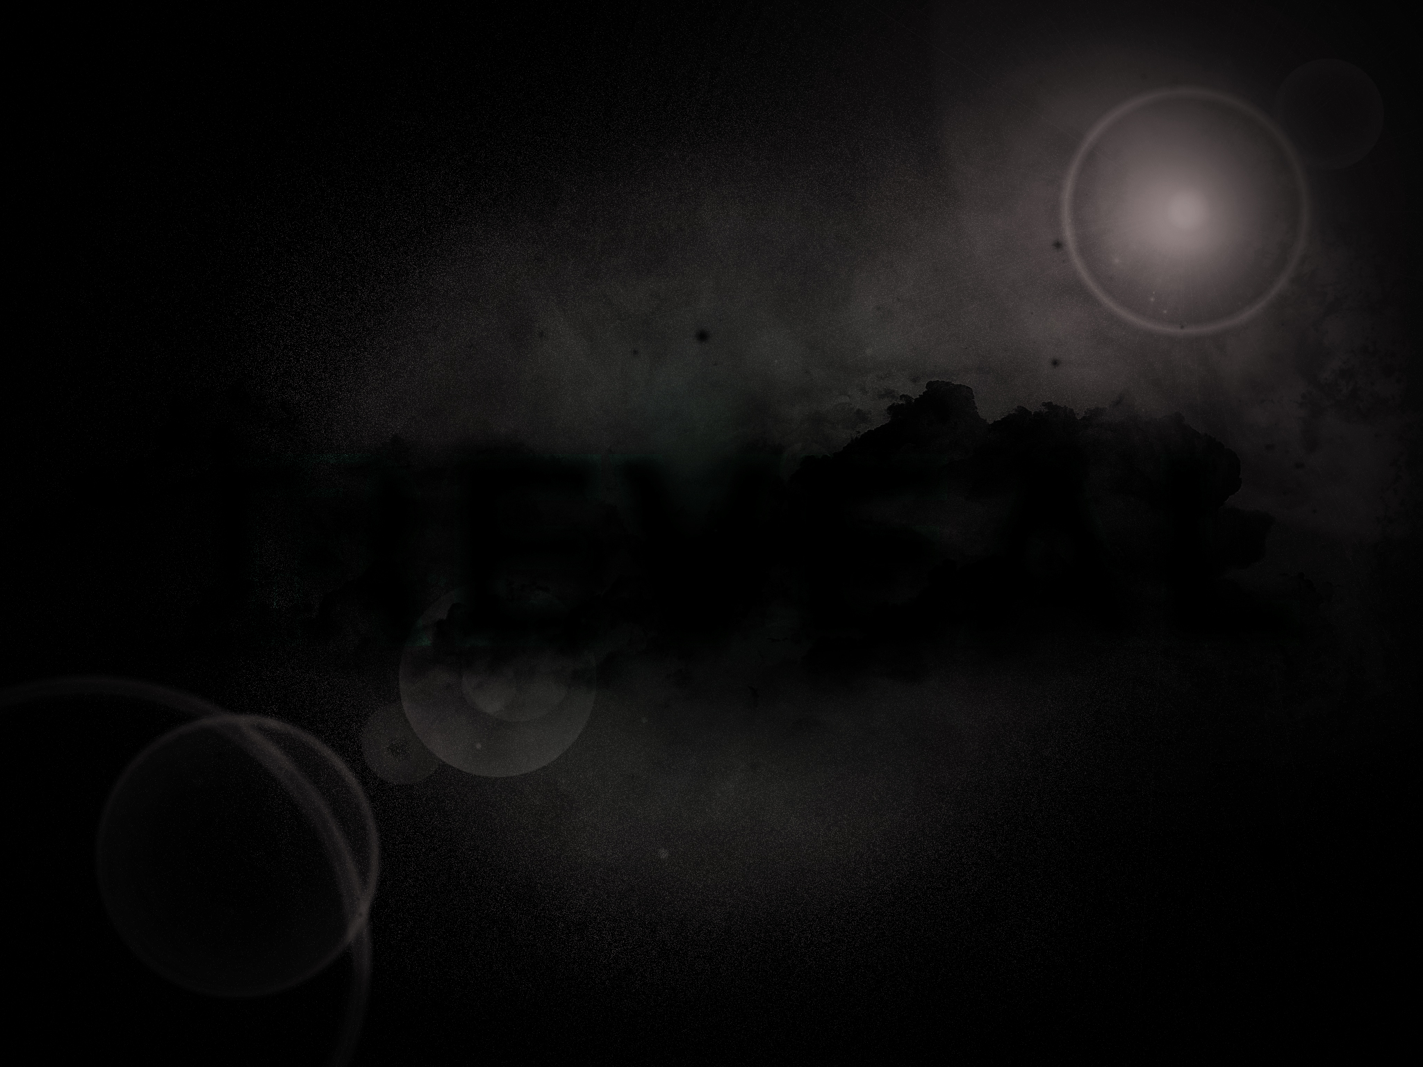
The Future
It intrigues us
It compels and motivates us
It charms us
It frightens us
It should encourage us

Slide 2
Revelation 1:1-3
The Revelation of Jesus Christ, which God gave Him to show to His bond-servants, the things which must soon take place; and He sent and communicated it by His angel to His bond-servant John,

Slide 3
who testified to the word of God and to the testimony of Jesus Christ, even to all that he saw. Blessed is he who reads and those who hear the words of the prophecy, and heed the things which are written in it; for the time is near.
New American Standard Bible : 1995 Update. LaHabra, CA : The Lockman Foundation, 1995

Slide 4
The Book of Revelation
Notice…singular, not plural
It is a gift
It is a revelation (duh!)
  It is an unveiling
  It engages the senses
  It is an experience

Slide 5
The Book of Revelation
It is for the Church
  Encourage steadfastness
  Prepare for opposition
  Call to repentance
  Promise of blessing

Slide 6
The Book of Revelation
It is historical and urgent
"History is not a haphazard sequence of unrelated events but a divinely decreed ordering of that which must take place." (Mounce, pg. 41)

Slide 7
The Book of Revelation
It is understandable
  Communication from God
  Testified by John
  Challenging does not mean impossible
It points us to Jesus Christ
  He is first
  He is foremost

Slide 8
The Book of Revelation
It is for a blessing
  Reminds of the glory of Jesus
  Encourages our worship
  Reminds us of judgement
  Reminds us of depravity
  Reminds of mercy and grace
  Assures us of victory and vindication

Slide 9
The Book of Revelation
It calls us to accountability
  We must read it
  We must hear it
  We must heed it

