Slide 1
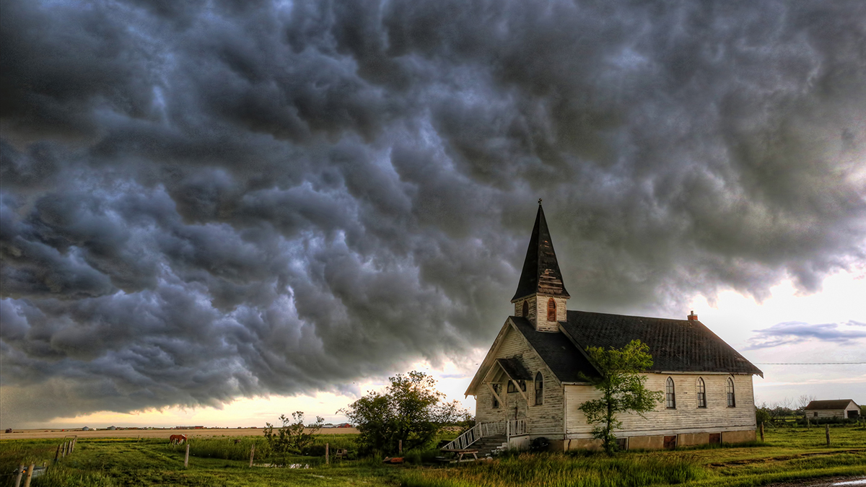

Slide 2
The Local Church
God ordained
God redeemed
God’s plan

Slide 3
The Local Church
Needs to be reminded
Of its significance
Of its calling
Needs to remember Who its Lord is

Slide 4
Revelation 1:10
I was in the Spirit on the Lord’s day, and I heard behind me a loud voice like the sound of a trumpet,

Slide 5
Revelation 1:12-16
Then I turned to see the voice that was speaking with me. And having turned I saw seven golden lampstands;

Slide 6
and in the middle of the lampstands I saw one like a son of man, clothed in a robe reaching to the feet, and girded across His chest with a golden sash.

Slide 7
His head and His hair were white like white wool, like snow; and His eyes were like a flame of fire.

Slide 8
His feet were like burnished bronze, when it has been made to glow in a furnace, and His voice was like the sound of many waters.

Slide 9
In His right hand He held seven stars, and out of His mouth came a sharp two-edged sword; and His face was like the sun shining in its strength.
New American Standard Bible : 1995 Update. LaHabra, CA : The Lockman Foundation, 1995

Slide 10
Remember the Context
Revelation is to the Church
Revelation is for the Church

Slide 11
Remember the Context
Jesus (ch. 1)
Instruction to churches (chs. 2-3)
Judgment (chs. 4-20)
Eternity (chs. 21-22)

Slide 12
Who is Jesus?
The One with real authority
He commands
He begins and ends
He has the keys

Slide 13
Who is Jesus?
He is the Prophet who speaks from God
He is the King who rules
He is the Priest who saves

Slide 14
Who is Jesus?
He is LORD
He is LORD of the Church…and churches

Slide 15
WHO is Jesus?
Like “for reals”
Not just position
Not just titles

Slide 16
WHO is Jesus?
A picture is worth a thousand words
He is purely pure
He sees with all insight
He is indomitably strong

Slide 17
What does Jesus do?
He holds
He wields judgment

Slide 18
Churches who Arise…
Overwhelmed by Jesus
Lifted up by Jesus

