Slide 1
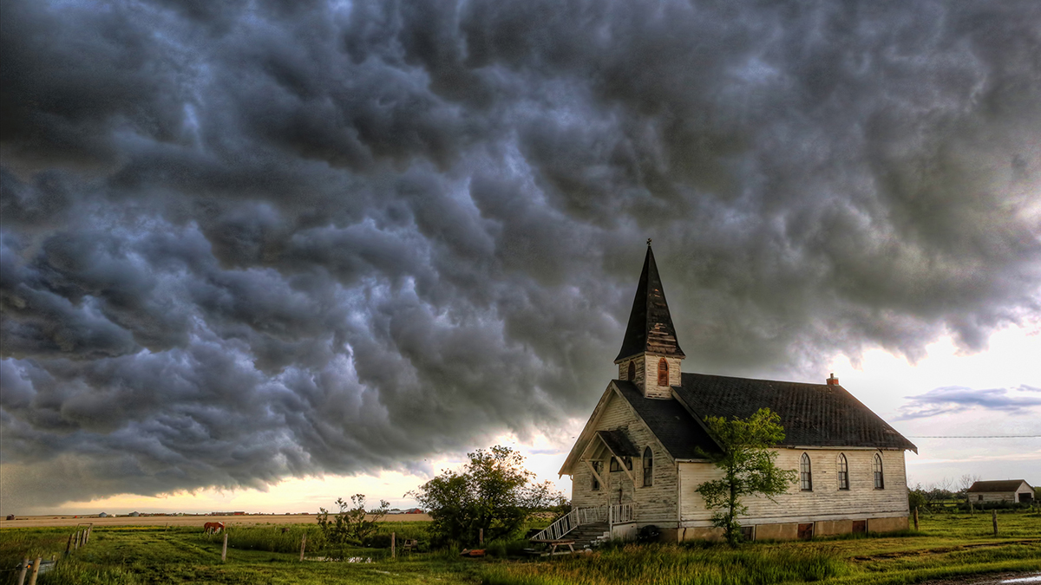

Slide 2
The Church in America
Weathered
State of disrepair
Seemingly neglected
In a storm

Slide 3
The Church in America
Convenience
Affections
Self-focus
Relic from a by-gone era

Slide 4
The Church in America
Acts…persecuted, scattered, and gathered
Today…comfortably gathered and scattered

Slide 5
The Church in America
Need to be reminded
Who, why, and what we are
Book of Revelation
The Church needs to rise!

Slide 6
Revelation 1:4-7
John to the seven churches that are in Asia: Grace to you and peace,

Slide 7
from Him who is and who was and who is to come, and from the seven Spirits who are before His throne,

Slide 8
and from Jesus Christ, the faithful witness, the firstborn of the dead, and the ruler of the kings of the earth. To Him who loves us and released us from our sins by His blood—

Slide 9
and He has made us to be a kingdom, priests to His God and Father—to Him be the glory and the dominion forever and ever. Amen.

Slide 10
Behold, He is coming with the clouds, and every eye will see Him, even those who pierced Him; and all the tribes of the earth will mourn over Him. So it is to be. Amen.
New American Standard Bible : 1995 Update. LaHabra, CA : The Lockman Foundation, 1995

Slide 11
A Disclaimer
Not a thorough study of Revelation
Not dealing with the “end times” per se
Setting the church in its context

Slide 12
Priority in the Revelation
For all believers
Each individual
Each local gathering
To show
What is to come…soon
What is near

Slide 13
Priority in God’s Purpose
Role of God’s people
Universal
Local

Slide 14
While the Church may be the hand of God, the local church is His fingers.

Slide 15
Priority in God’s Plan
Book of Revelation
Jesus…vindication
Jesus…conclusion

Slide 16
Priority in God’s Plan
Context of Revelation
Jesus (ch. 1)
Churches (chs. 2-3)
Judgment (chs. 4-20)
Eternity (chs. 21-22)

Slide 17
What should this tell us?

Slide 18
The local church is…
Powerfully significant
Called and empowered
Not to be neglected
In need of dramatic urgency

Slide 19
Churches who Arise…
Are consumed by serving Jesus
Hold true to their purpose
Are filled with urgency

Slide 20
Hebrews 10:24-25
“…let us consider how to stimulate one another to love and good deeds,

Slide 21
not forsaking our own assembling together, as is the habit of some, but encouraging one another; and all the more as you see the day drawing near.”
New American Standard Bible : 1995 Update. LaHabra, CA : The Lockman Foundation, 1995

