Slide 1
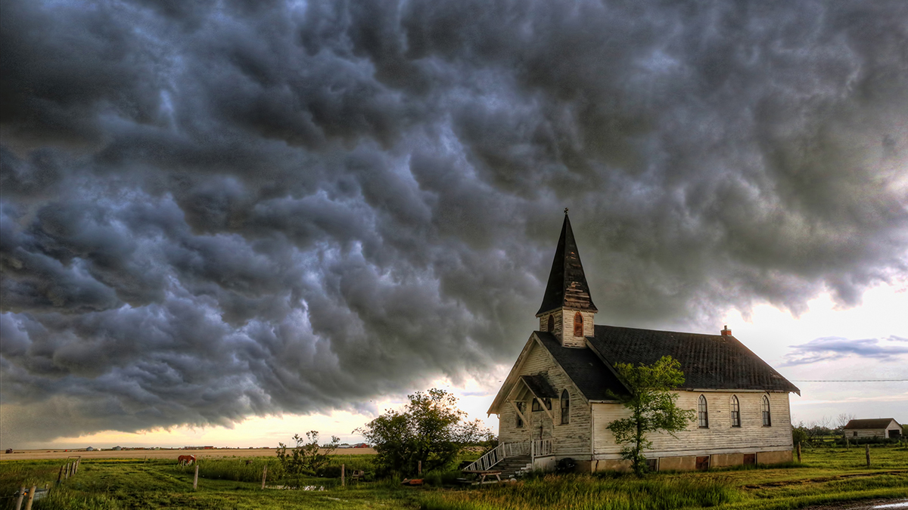

Slide 2
The Local Church
Significant…God’s plan
Significant…its Lord
Significant…its context

Slide 3
The Local Church
Must be consumed with Jesus
Must live with urgency

Slide 4
2nd Peter 3:10-15
But the day of the Lord will come like a thief, in which the heavens will pass away with a roar

Slide 5
and the elements will be destroyed with intense heat, and the earth and its works will be burned up.

Slide 6
Since all these things are to be destroyed in this way, what sort of people ought you to be in holy conduct and godliness,

Slide 7
looking for and hastening the coming of the day of God, because of which the heavens will be destroyed by burning, and the elements will melt with intense heat!

Slide 8
But according to His promise we are looking for new heavens and a new earth, in which righteousness dwells.

Slide 9
Therefore, beloved, since you look for these things, be diligent to be found by Him in peace, spotless and blameless,

Slide 10
and regard the patience of our Lord as salvation; just as also our beloved brother Paul, according to the wisdom given him, wrote to you,
New American Standard Bible : 1995 Update. LaHabra, CA : The Lockman Foundation, 1995

Slide 11
Remember the Context
The glorified Christ (ch. 1)
Instruction to churches (chs. 2-3)
Judgment (chs. 4-20)
Eternity (chs. 21-22)

Slide 12
Urgency…spiritual condition
Unrelenting arrogance
They can outwit God
They can escape God

Slide 13
Urgency…spiritual condition
Hardness of heart
Blasphemous anger
Curse God
Slander God
They recognize yet refuse

Slide 14
Urgency…the apocalypse
God’s wrath
Wrath…holy anger and vengeance
Wrath of the Lamb
Powerfully mixed metaphor

Slide 15
The glorified Lamb of God is no longer a baby in a manger nor a mere martyr hanging on a cross…

Slide 16
He is the LORD who judges and wages war against sin. The lamb is a fierce and mighty warrior.

Slide 17
Urgency…the apocalypse
Plagues
The story of the Exodus
See God’s power
Experience God’s judgement
Goal…know God

Slide 18
Urgency…the End
Defeat
Complete
Inescapable
Final…there is no “next year”

Slide 19
Urgency…the End
Judgement
A legal proceeding
Indisputable
Eternal

Slide 20
“…since all kinds of people are included, we cannot say that God's wrath is directed only at the powerful, at the rich, or at false Christians…

Slide 21
His judgment will fall on all…”
(Johnson, Expositors)

Slide 22
Churches who Arise…
Trust the fullness of God’s promises
Understand what is primary
Take sin seriously
Love their neighbors

