Slide 1
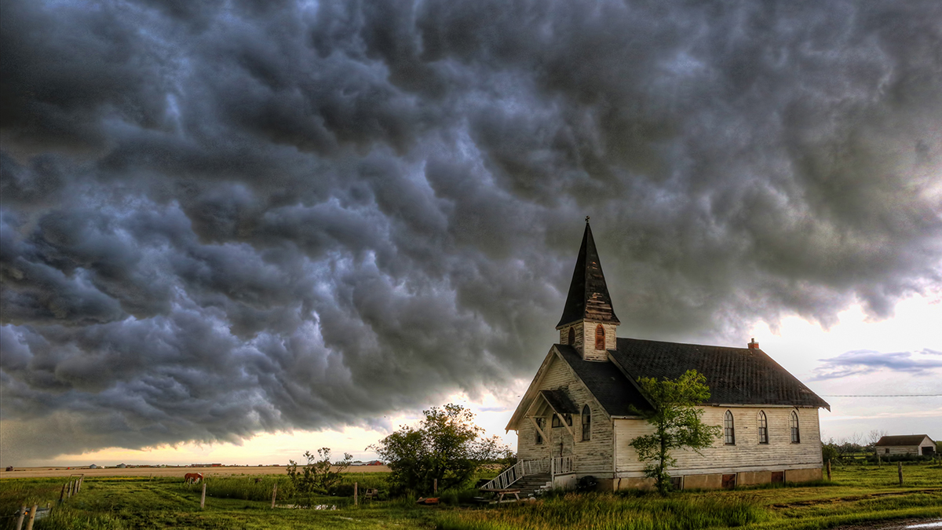

Slide 2
The Local Church
Are stars in the hand of the Savior
Are His precious possession
Has mail from the Master…

Slide 3
Revelation 2:1-7
“To the angel of the church in Ephesus write: The One who holds the seven stars in His right hand, the One who walks among the seven golden lampstands, says this:

Slide 4
‘I know your deeds and your toil and perseverance, and that you cannot tolerate evil men, and you put to the test those who call themselves apostles, and they are not, and you found them to be false;

Slide 5
and you have perseverance and have endured for My name’s sake, and have not grown weary. But I have this against you, that you have left your first love.

Slide 6
Therefore remember from where you have fallen, and repent and do the deeds you did at first; or else I am coming to you and will remove your lampstand out of its place—unless you repent.

Slide 7
Yet this you do have, that you hate the deeds of the Nicolaitans, which I also hate. He who has an ear, let him hear what the Spirit says to the churches.

Slide 8
To him who overcomes, I will grant to eat of the tree of life which is in the Paradise of God.’”
New American Standard Bible : 1995 Update. LaHabra, CA : The Lockman Foundation, 1995

Slide 9
Location of the Church
Most prominent city
Population 250k+
Centerpiece was the temple of Diana
Legend
Prostitutes
Church began in Acts 18

Slide 10
The Lord of the Church
He is Lord of the Church – it is His
He is present with His Church
He has full knowledge of His Church

Slide 11
What you will find if you attend
Tireless toiling for truth
Faithful to Paul’s words
Tolerance has limits
Endurance amid intense pressure

Slide 12
What you will find if you attend
Holy hatred
Nicolaitans – encouraged immoral cultural participation
For their deeds
For their influence

Slide 13
What you won’t find if you attend
God’s full pleasure
Brings a legal charge
Can’t ignore what’s lacking

Slide 14
What you won’t find if you attend
Heart-felt love
Of upmost importance
Love God (Mark 12:28-30)
Love others (Mark 12:31)
Love the brethren (1st Peter 1:22)
Affection replaced by habit

Slide 15
“Loving devotion to Christ can be lost in the midst of active service, and certainly no amount of orthodoxy can make up for a failure to love one another.”
(Expositor’s)

Slide 16
“…maintenance of…success had become more important than the motivation for service, namely, the love for Christ.” (Patterson, pg. 86)

Slide 17
Churches who Arise…
Recognize the danger
Repent
Repent collectively
Remember
Return
Do the deeds

Slide 18
Churches who Arise…
Repent individually
Trust the promise

