Slide 1
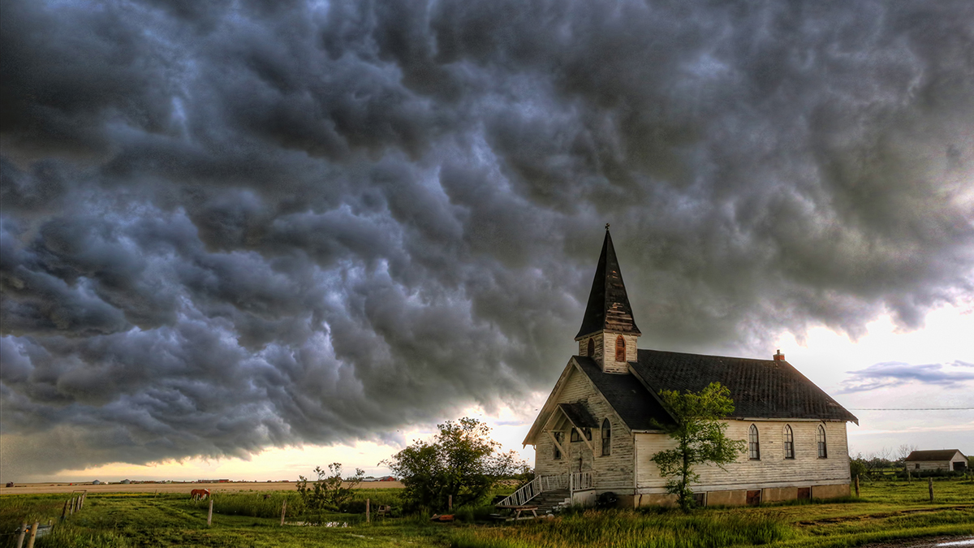

Slide 2
The Local Church
Are stars in the hand of the Savior
Are His precious possession
Has mail from the Master…

Slide 3
Revelation 2:8-11
“And to the angel of the church in Smyrna write: The first and the last, who was dead, and has come to life, says this:

Slide 4
‘I know your tribulation and your poverty (but you are rich), and the blasphemy by those who say they are Jews and are not, but are a synagogue of Satan.

Slide 5
‘Do not fear what you are about to suffer. Behold, the devil is about to cast some of you into prison, so that you will be tested,

Slide 6
and you will have tribulation for ten days. Be faithful until death, and I will give you the crown of life.

Slide 7
‘He who has an ear, let him hear what the Spirit says to the churches. He who overcomes will not be hurt by the second death.’
New American Standard Bible : 1995 Update. LaHabra, CA : The Lockman Foundation, 1995

Slide 8
Location of the Church
Called the most beautiful city in Asia Minor
Population roughly 250k
While independent, was very loyal to Rome
Large Jewish population

Slide 9
Location of the Church
Culturally elite
Stadium (athletics)
Library (education)
Largest theater in Asia Minor (the arts)
The birthplace of the poet, Homer

Slide 10
The Lord of the Church
Introductions
Not random
Not filler
Introductions
Specific truth
Unites theology with life

Slide 11
Theology is never abstract trivia but, rather, a foundation for faithful living.

Slide 12
The Lord of the Church
Eternal Lord
Source of life
Determiner of life
Holder of life

Slide 13
“…while Smyrna can take away one’s present life, Jesus guarantees one’s future life…their ultimate future was…secure…”
(Osborne, pg. 128-129)

Slide 14
The Lord of the Church
Resurrected Lord
He was found guilty
He died
He was vindicated
So will those who believe

Slide 15
“As He was victorious over death, so they too, can face martyrdom knowing that faithfulness is rewarded with eternal life.”
(Mounce, pg. 74)

Slide 16
What you will find if you attend
Tribulation
A persecuted people
Primarily from Jews
Politically motivated
Christians viewed as a sect of Judaism

Slide 17
“Jews were active in denouncing Christians to the authorities, possibly to deflect attention from themselves.

Slide 18
Rome had given the Jews the right to practice their religion, and they did not want this precious privilege threatened.”
(Osborne, pg. 127)

Slide 19
What you will find if you attend
An impoverished people
Completely destitute
Direct result of persecution

Slide 20
What you will find if you attend
A blasphemed people
Cannibalism
Hedonism
Atheism
Arsonists
Treason

Slide 21
What you will find if you attend
A people with hope
Fellowship
No reason to fear
Purposeful
Short duration
Reward of life

Slide 22
“Though their own lives might be sacrificed, their real riches were as far removed from this world as the heavens are above the earth.” (Walvoord, pg. 63)

Slide 23
Churches who Arise…
Are not shocked
Have insight
Have an eternal perspective
Trust their Lord

