Slide 1
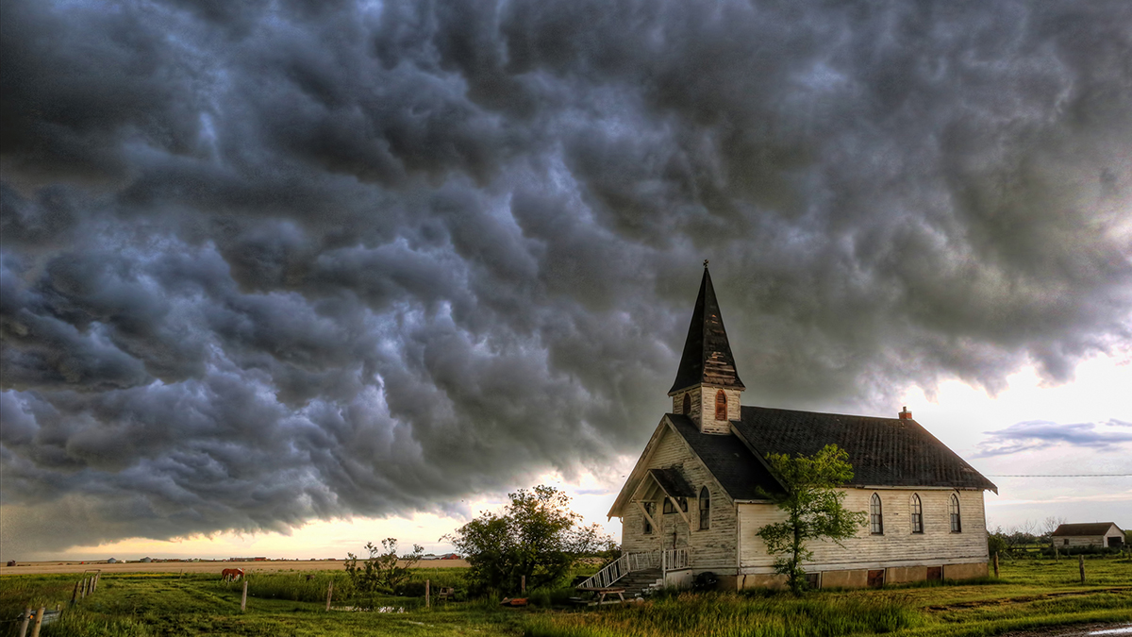

Slide 2
The Local Church
Are stars in the hand of the Savior
Are integral to His redemptive purpose
Has mail from the Master…

Slide 3
Revelation 2:18-29
“And to the angel of the church in Thyatira write: The Son of God, who has eyes like a flame of fire, and His feet are like burnished bronze, says this:

Slide 4
‘I know your deeds, and your love and faith and service and perseverance, and that your deeds of late are greater than at first.

Slide 5
But I have this against you, that you tolerate the woman Jezebel, who calls herself a prophetess, and she teaches and leads My bond-servants astray so that they commit acts of immorality and eat things sacrificed to idols.

Slide 6
I gave her time to repent, and she does not want to repent of her immorality. Behold, I will throw her on a bed of sickness, and those who commit adultery with her into great tribulation, unless they repent of her deeds.

Slide 7
And I will kill her children with pestilence, and all the churches will know that I am He who searches the minds and hearts; and I will give to each one of you according to your deeds.

Slide 8
But I say to you, the rest who are in Thyatira, who do not hold this teaching, who have not known the deep things of Satan, as they call them—I place no other burden on you.

Slide 9
Nevertheless what you have, hold fast until I come. He who overcomes, and he who keeps My deeds until the end, to him I will give authority over the nations;

Slide 10
and he shall rule them with a rod of iron, as the vessels of the potter are broken to pieces, as I also have received authority from My Father;

Slide 11
and I will give him the morning star. He who has an ear, let him hear what the Spirit says to the churches.’”
New American Standard Bible : 1995 Update. LaHabra, CA : The Lockman Foundation, 1995

Slide 12
Location of the Church
Established as a military outpost
Defensive buffer for Pergamum
Before Roman annex in 190 BC destroyed and rebuilt often

Slide 13
Location of the Church
Smallest of the seven cities
Not significant religiously or politically
Significance was commercial
Life revolved around trade guilds (unions)

Slide 14
The Lord of the Church
He is the Son of God
His gaze is penetrating
His knowledge is complete
Religious exterior is unable to cover what’s inside

Slide 15
The Lord of the Church
He rules with purity of strength
What He sees He is able to deal with

Slide 16
What you will find if you attend
An active church
A church of good deeds
Love
Faith
Service
Perseverance

Slide 17
What you will find if you attend
Ministry growth
Ministry development
Everything we would look for

Slide 18
What you will find if you attend
Inward decay
Tolerance for ungodliness
Leadership
Teaching
Worldliness
Refusal to repent

Slide 19
Their diligence in service wasn’t supported by nor built upon theological vigilance; a loving heart not empowered by a biblically sound mind will yield less than Christ-honoring results

Slide 20
What you will find if you attend
Coming judgment
Dramatic and decisive
Unmistakable
For God’s glory

Slide 21
Just as the church at Ephesus could not excuse its lack of love and good deeds because of their superior teaching and theology…

Slide 22
…the church at Thyatira could not excuse its lack of biblical teaching and its resulting worldliness because of its social value and actions.

Slide 23
Encouragement to the Church
Hold fast
Overcome
Keep My deeds
Promise of glory and authority

Slide 24
Churches who Arise…
Are not tolerant
Are driven by sound, biblical instruction
Are characterized by Christ-like social actions
Live lives of repentance

