Slide 1
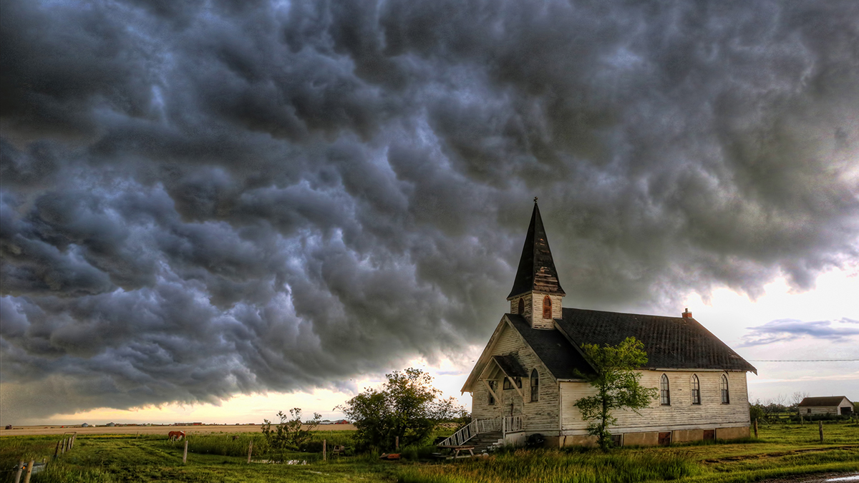

Slide 2
Revelation 3:1-6
“To the angel of the church in Sardis write: He who has the seven Spirits of God and the seven stars, says this: ‘I know your deeds, that you have a name that you are alive, but you are dead.

Slide 3
Wake up, and strengthen the things that remain, which were about to die; for I have not found your deeds completed in the sight of My God.

Slide 4
So remember what you have received and heard; and keep it, and repent. Therefore if you do not wake up, I will come like a thief, and you will not know at what hour I will come to you.

Slide 5
But you have a few people in Sardis who have not soiled their garments; and they will walk with Me in white, for they are worthy.

Slide 6
He who overcomes will thus be clothed in white garments; and I will not erase his name from the book of life, and I will confess his name before My Father and before His angels.

Slide 7
He who has an ear, let him hear what the Spirit says to the churches.’”
New American Standard Bible : 1995 Update. LaHabra, CA : The Lockman Foundation, 1995

Slide 8
Location of the Church
Located about 30 miles east of Ephesus
A history of glory and splendor
…with the emphasis on “history”

Slide 9
Location of the Church
Famous for its gold
Known for its jewelry
First place to mint gold coins

Slide 10
Location of the Church
Sadly, a history of disaster via neglect and complacency
It was “…a picture of unanticipated quick tragedy.” (Patterson, pg. 121)

Slide 11
Location of the Church
It’s security was its assumed unassailable position on Mt. Tmolus.
Twice overthrown due to arrogant inattention
Once destroyed by an earthquake

Slide 12
The Lord of the Church
The Seven Spirits – the Holy Spirit
The Seven Stars – the seven churches
Stresses the vitality of relationship with all three

Slide 13
What you will find if you attend
Nothing good!
“It is a sad thing when the only ‘deed’ of a church is what it names itself…” (Osborne, pg. 174)

Slide 14
What you will find if you attend
The look of life, the smell of death
A striking picture…their most noticeable landmark

Slide 15
As a church, Sardis was no better than the Pharisees who Jesus described as…

Slide 16
“…whitewashed tombs which on the outside appear beautiful, but inside they are full of dead men’s bones…” (Matthew 23:27)

Slide 17
What you will find if you attend
A church on probation
Wake up…be watchful
Strengthen…fulfill
Remember…history
Keep…actively guard
Repent!

Slide 18
What you will find if you attend
Promise of judgment
It will be sudden
It will be swift
It will be decisive

Slide 19
“Allusion to the fate of the city of Sardis in days long past is obvious here. Just as the overconfident city, unaware of the enemy scaling its walls, fell when least expected;

Slide 20
so, too, the church at Sardis, with its reputation for life, stood at that moment imperiled by a thief-like visit from God, which would result in its destruction.

Slide 21
The threat suggests dead and dying churches are frequently oblivious to either their condition or to the imminent threat.” (Patterson, pg. 122)

Slide 22
Encouragement to the Church
There is hope!
White…righteousness
Made righteous by Christ
Live in righteousness with Christ
Name…security

Slide 23
Churches who Arise…
Know and understand the gospel
Vigilantly watchful
Take judgment seriously

