Slide 1
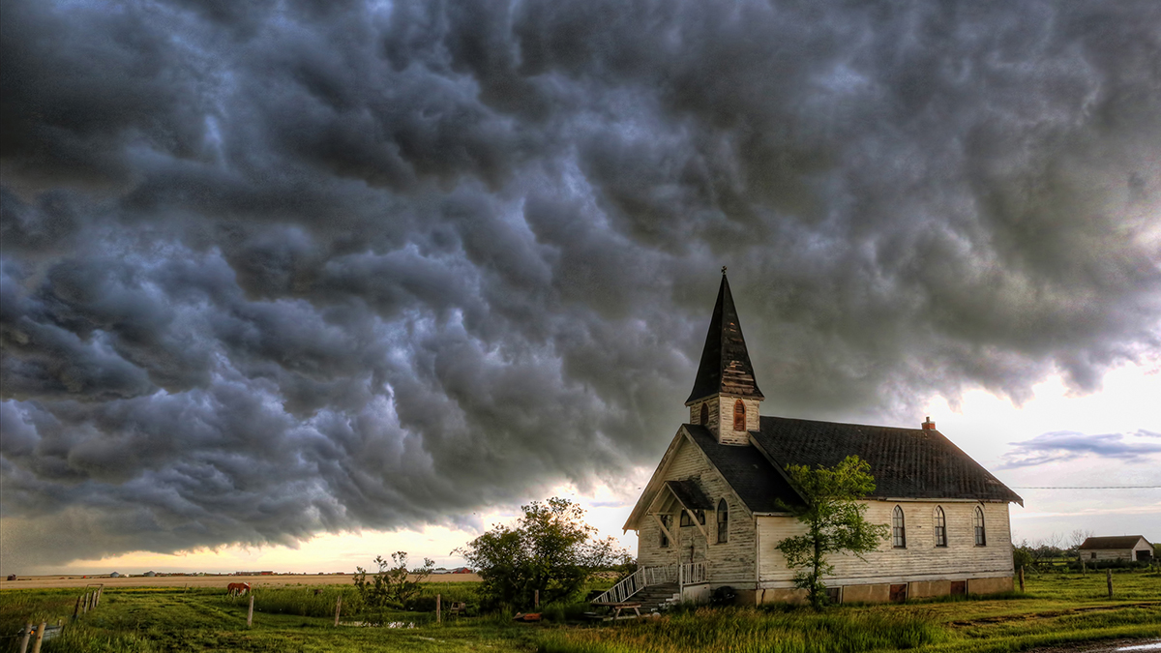

Slide 2
Revelation 3:7-13
“And to the angel of the church in Philadelphia write: He who is holy, who is true, who has the key of David, who opens and no one will shut, and who shuts and no one opens, says this:

Slide 3
‘I know your deeds. Behold, I have put before you an open door which no one can shut, because you have a little power, and have kept My word, and have not denied My name.

Slide 4
Behold, I will cause those of the synagogue of Satan, who say that they are Jews and are not, but lie—I will make them come and bow down at your feet, and make them know that I have loved you.

Slide 5
Because you have kept the word of My perseverance, I also will keep you from the hour of testing, that hour which is about to come upon the whole world, to test those who dwell on the earth.

Slide 6
I am coming quickly; hold fast what you have, so that no one will take your crown. He who overcomes, I will make him a pillar in the temple of My God, and he will not go out from it anymore;

Slide 7
and I will write on him the name of My God, and the name of the city of My God, the new Jerusalem, which comes down out of heaven from My God, and My new name.

Slide 8
He who has an ear, let him hear what the Spirit says to the churches.’”
New American Standard Bible : 1995 Update. LaHabra, CA : The Lockman Foundation, 1995

Slide 9
Location of the Church
City of special significance
Rivaled Ephesus
Postal and trade route
City with a special beginning
City of Brotherly Love
Formed out of relationship between two brothers

Slide 10
Location of the Church
Known for an “open door” for commerce.
Most citizens lived outside the city walls due to fear

Slide 11
The Lord of the Church
He is Holy
Set apart from sin
Unblemished and flawless
All encompassing
His actions are holy

Slide 12
The Lord of the Church
He is True
Genuine and authentic
His word is true
His promises are true

Slide 13
"When confronted by Christ, we are confronted by no shadowy outline of the truth, but with the truth itself." (Thomas, pg. 273)

Slide 14
The Lord of the Church
He is the Key-master
Right and authority
Accessibility
Holder of destinies

Slide 15
What you will find if you attend
Small in stature
Numerically
Culturally
Keep His word – ministry
Keep His word – faithfulness
Keep His word – perseverance

Slide 16
Encouragement to the Church
Hold fast!
Vindication
Preservation
Security
Permanence

Slide 17
“…both the city (due to earthquakes) and the church (due to persecution) had never felt security or permanence, so this promise must have been most welcome.” (Osborne, pg. 196)

Slide 18
"To those who have ‘little strength’ (little influence) because of being ostracized, Christ promises recognition in his kingdom worthy of the most noble hero of any society." (Johnson, Expositors)

Slide 19
Churches who Arise…
Faithful to the word
Faithful to live the word
Faithful to minister the word

