Slide 1
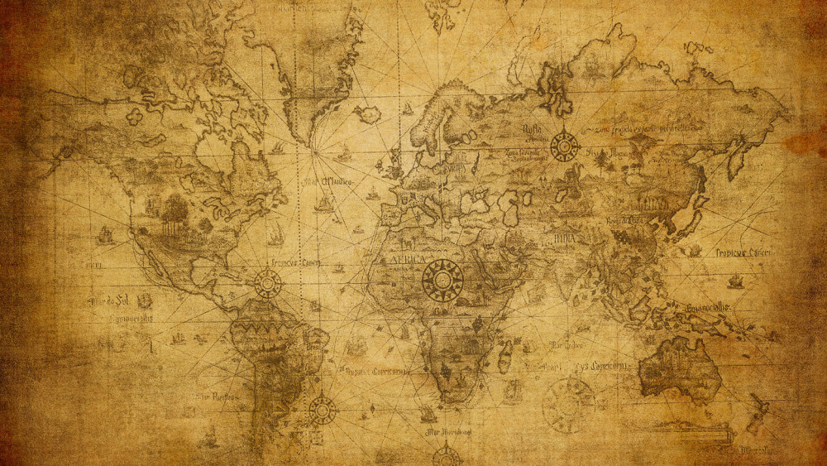

Slide 2
The Sovereignty of God
What people hear…God does what He wants
What we hear…God works things out for me
What God means…I will accomplish my purposes

Slide 3
The Purposes of God
The faithfulness of His people
A light to the nations
The salvation of sinners
His glory throughout creation
Daniel chapter 1 sets the table

Slide 4
Daniel 1:1-7
In the third year of the reign of Jehoiakim king of Judah, Nebuchadnezzar king of Babylon came to Jerusalem and besieged it.

Slide 5
The Lord gave Jehoiakim king of Judah into his hand, along with some of the vessels of the house of God; and he brought them to the land of Shinar, to the house of his god, and he brought the vessels into the treasury of his god.

Slide 6
Then the king ordered Ashpenaz, the chief of his officials, to bring in some of the sons of Israel, including some of the royal family and of the nobles,

Slide 7
youths in whom was no defect, who were good-looking, showing intelligence in every branch of wisdom, endowed with understanding and discerning knowledge, and who had ability for serving in the king’s court;

Slide 8
and he ordered him to teach them the literature and language of the Chaldeans.

Slide 9
The king appointed for them a daily ration from the king’s choice food and from the wine which he drank, and appointed that they should be educated three years, at the end of which they were to enter the king’s personal service.

Slide 10
Now among them from the sons of Judah were Daniel, Hananiah, Mishael and Azariah. Then the commander of the officials assigned new names to them;

Slide 11
and to Daniel he assigned the name Belteshazzar, to Hananiah Shadrach, to Mishael Meshach and to Azariah Abed-nego.
New American Standard Bible : 1995 Update. LaHabra, CA : The Lockman Foundation, 1995

Slide 12
God gave…subjection
Subjection of their nation
Subjection of their religion
Subjection of their royalty
By God and for God
Because of their sin
Because of God’s faithfulness

Slide 13
"It was not Nebuchadnezzar's strength nor Jehoiakim's weakness that really decided the matter, but God's good pleasure. (Wood, pg. 30)
“Nebuchadnezzar was not acting in opposition to the will of God. In fact, whatever success Nebuchadnezzar enjoyed was provided by God…” (Baker Dictionary of Theology)

Slide 14
God gave…favor
Favor – God’s love for His people
Favor working with conviction
Favor working with character
Favor working with perseverance

Slide 15
God gave…blessing
Vindication
Growth
Redemption

Slide 16
“…the point here is…theological, not simply chronological. The first year of Cyrus marks the beginning of the restoration era…when the king of Babylon was long dead, God's servant continued to live and his people were restored.” (New Bible Commentary)

Slide 17
Dare to be a Daniel
Sin brings faithful judgment
Biblical conviction does not mean arrogant and obstinate behavior
Favor works with character
Blessing works with faithfulness

Slide 18
Isaiah 46:8-11
“Remember this, and be assured; Recall it to mind, you transgressors. Remember the former things long past, For I am God, and there is no other; I am God, and there is no one like Me,

Slide 19
Declaring the end from the beginning, And from ancient times things which have not been done, Saying, ‘My purpose will be established, And I will accomplish all My good pleasure’;

Slide 20
Calling a bird of prey from the east, The man of My purpose from a far country. Truly I have spoken; truly I will bring it to pass. I have planned it, surely I will do it.”
New American Standard Bible : 1995 Update. LaHabra, CA : The Lockman Foundation, 1995

