Slide 1
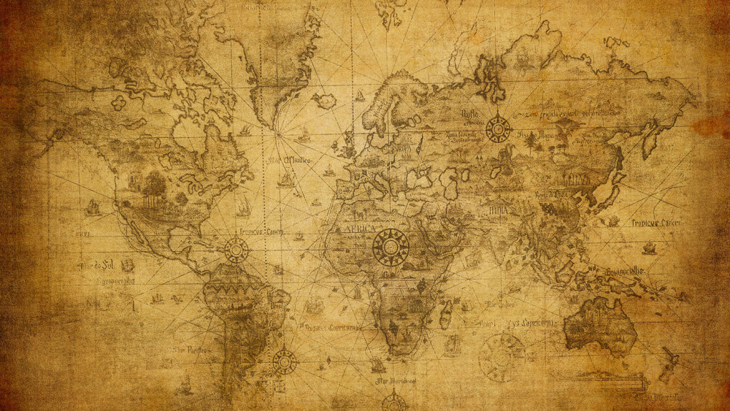
The holder of history and destiny
God…

Slide 2
Daniel 1:1-7
In the third year of the reign of Jehoiakim king of Judah, Nebuchadnezzar king of Babylon came to Jerusalem and besieged it.

Slide 3
The Lord gave Jehoiakim king of Judah into his hand, along with some of the vessels of the house of God; and he brought them to the land of Shinar, to the house of his god, and he brought the vessels into the treasury of his god.

Slide 4
Then the king ordered Ashpenaz, the chief of his officials, to bring in some of the sons of Israel, including some of the royal family and of the nobles,

Slide 5
youths in whom was no defect, who were good-looking, showing intelligence in every branch of wisdom, endowed with understanding and discerning knowledge, and who had ability for serving in the king’s court;
New American Standard Bible : 1995 Update. LaHabra, CA : The Lockman Foundation, 1995

Slide 6
The Storyline
Judah taken captive by Babylon
Daniel and friends
Faith on display
Life was harsh
Life was filled with favor and blessing

Slide 7
Daniel: Gospel Imagery
God judges sin
God takes action to save
Repentance not rejection
Light in darkness
Godly first to go

Slide 8
Daniel: Gospel Imagery
God gives grace amid judgment
Preservation
Favor and blessing
God provides a suffering servant
Provision for His people
Deliverance for sinners

Slide 9
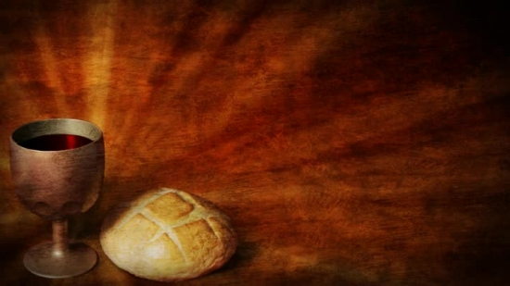
We Celebrate
God judges sin…our sin
God took action to save
God gives grace
God sent the Suffering Servant

Slide 10
We Celebrate
The Bread…Jesus
Conquered sin
Conquered death
The Cup…Promise
Forgiveness
Assurance

