Slide 1
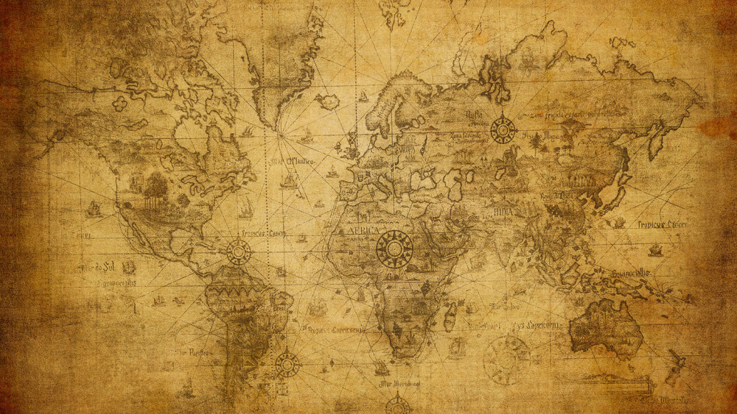

Slide 2
The Storyline
God’s Sovereignty
Gave bondage
Granted favor and blessing
For the duration
Daniel’s Experience
Challenge
Danger

Slide 3
The Storyline
The reader is prepared
God’s oversight
God’s provision
The reader is confronted…
To what end is the blessing and favor of God?

Slide 4
Blessing and Favor of God
What we think…
Comfort and convenience
Ease of living
What God intends…
Sustaining grace
Persevering strength
To accomplish His purposes

Slide 5
Daniel 2:1-6
Now in the second year of the reign of Nebuchadnezzar, Nebuchadnezzar had dreams; and his spirit was troubled and his sleep left him.

Slide 6
Then the king gave orders to call in the magicians, the conjurers, the sorcerers and the Chaldeans to tell the king his dreams. So they came in and stood before the king.

Slide 7
The king said to them, “I had a dream and my spirit is anxious to understand the dream.” Then the Chaldeans spoke to the king in Aramaic: “O king, live forever! Tell the dream to your servants, and we will declare the interpretation.”

Slide 8
The king replied to the Chaldeans, “The command from me is firm: if you do not make known to me the dream and its interpretation, you will be torn limb from limb and your houses will be made a rubbish heap.

Slide 9
“But if you declare the dream and its interpretation, you will receive from me gifts and a reward and great honor; therefore declare to me the dream and its interpretation.”
New American Standard Bible : 1995 Update. LaHabra, CA : The Lockman Foundation, 1995

Slide 10
God sends a dream
CAUTION! Don’t be distracted
Dreams in the Bible
Direction concerning the people of God
Accomplishing the purposes of God
Not personal nor mundane

Slide 11
God sends a dream
One dream amid many
A divine hit in the head with a hammer
A divine wake-up call
“…his spirit smote itself…” (Wood, pg. 50)

Slide 12
The king sends a message
I need to know
I need to trust
I need to protect myself
“Nebuchadnezzar had numerous virtues, but self-control was not one of them.” (Wood, pg. 55)

Slide 13
Daniel sends word
A word of assurance
He acted on faith
He trusted God
He trusted God’s provision

Slide 14
“He evidenced no despair, no panic, no frustration, but only spoke wise words in response. People live and act in the moment of crisis as they have prepared themselves through previous experiences. Daniel demonstrated his sterling character, developed through prior days of trusting God.” (Wood, pg. 56)

Slide 15
Daniel sends word
A word to request
Compassion
Preservation

Slide 16
“Here is a beautiful picture…this was a life-and-death crisis, and they pleaded with God to have mercy on them and to preserve their lives.” (Miller, pg. 85)

Slide 17
Daniel sends word
A word of praise
For His glory and attributes
For His sovereignty
For His grace
For what He has done

Slide 18
Dare to be a Daniel
Blessing and favor do not always mean comfort and convenience
Dire straits are opportunities in hand
For my faith to live
For God’s glory to shine

Slide 19
Psalm 33:8-12
Let all the earth fear the Lord; Let all the inhabitants of the world stand in awe of Him. For He spoke, and it was done; He commanded, and it stood fast.

Slide 20
The Lord nullifies the counsel of the nations; He frustrates the plans of the peoples. The counsel of the Lord stands forever, The plans of His heart from generation to generation.

Slide 21
Blessed is the nation whose God is the Lord, The people whom He has chosen for His own inheritance.
New American Standard Bible : 1995 Update. LaHabra, CA : The Lockman Foundation, 1995

