Slide 1
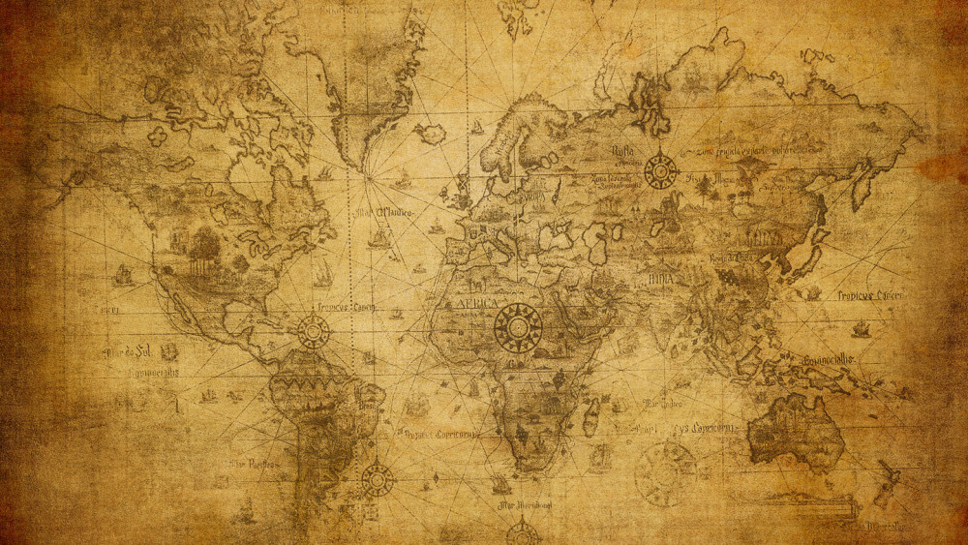

Slide 2
The Book of Daniel
Great stories of faith
Fascinating characters
A book of “Look, a squirrel!” and “Oooo…a shiny thing!”
Lots of distractions
Easy to miss the point

Slide 3
The Book of Daniel
Main Point: God is Lord…
Over people
Over rulers and nations
Over history
He is the holder of both history and destiny

Slide 4
Daniel 4:1-3
Nebuchadnezzar the king to all the peoples, nations, and men of every language that live in all the earth: “May your peace abound!

Slide 5
“It has seemed good to me to declare the signs and wonders which the Most High God has done for me.

Slide 6
“How great are His signs And how mighty are His wonders! His kingdom is an everlasting kingdom And His dominion is from generation to generation.
New American Standard Bible : 1995 Update. LaHabra, CA : The Lockman Foundation, 1995

Slide 7
Daniel 4:34-35
“…I blessed the Most High and praised and honored Him who lives forever; For His dominion is an everlasting dominion, And His kingdom endures from generation to generation.

Slide 8
All the inhabitants of the earth are accounted as nothing, But He does according to His will in the host of heaven And among the inhabitants of earth; And no one can ward off His hand Or say to Him, ‘What have You done?’”
New American Standard Bible : 1995 Update. LaHabra, CA : The Lockman Foundation, 1995

Slide 9
Who was Daniel?
Unquestionably real
Born during the reign of Josiah
At age 11 Judah fell to Egypt
At age 15 deported to Babylon after Egypt defeated
He knew the best and the worst

Slide 10
Who was Daniel?
Functioned as an untraditional prophet
True role was that of godly statesman
He was a man of prayer
He is a standard of faithfulness

Slide 11
The Content of the Book
Historical…provides details to Judah’s exile
Personal…another Joseph
Prophetic…national and world
Key to Matthew 24-25
Key to Book of Revelation

Slide 12
The Purpose of the Book
Demonstration of faithfulness during unfaithful days
Demonstration of grace
To give hope
God is in control
God has not abandoned

Slide 13
“The Book of Daniel was in an outstanding sense a book of comfort, designed for evil days as well as for the good days.” (Leupold, pg. 27)

Slide 14
The Purpose of the Book
To point to God
His omniscience
His omnipotence
His faithfulness
His sovereign Lordship

Slide 15
“Our times are in His hands, since the affairs of earth are not unconnected with those of heaven. He is a God who makes Himself and His purposes known, so that His people may know Him and rely on His word.

Slide 16
Such knowledge enables God's people to resist pressure knowing that they will share in the fulfillment of his kingdom.” (New Bible Commentary)

Slide 17
What’s in it for us?
Submit our will to the Lord’s
Entrust our days to Him
Be at peace within our circumstances

